Slide 1
Emerging AI Boot Camp
Srikar
Srinag
Notes:
Hi, I’m ___, and I’m excited to discuss Microsoft’s Cortana Intelligence Suite, and the value it can deliver to your organization.

Slide 2
Agenda
Context on 2 days Bootcamps
How CNN Works
How is it Evolved
Deep Dive on a Image Processing
Cognitive Services
Bot Service
LUIS

Slide 3
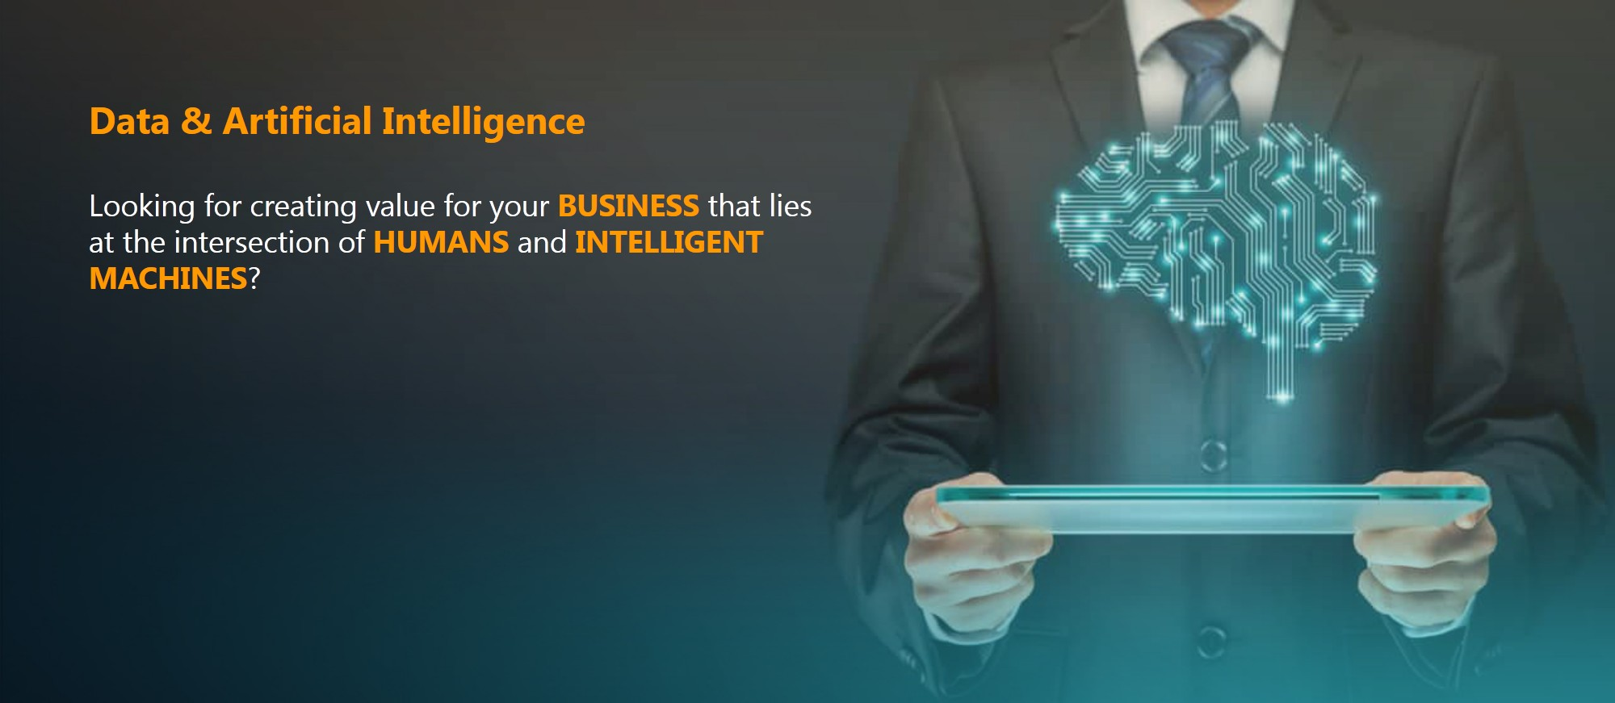
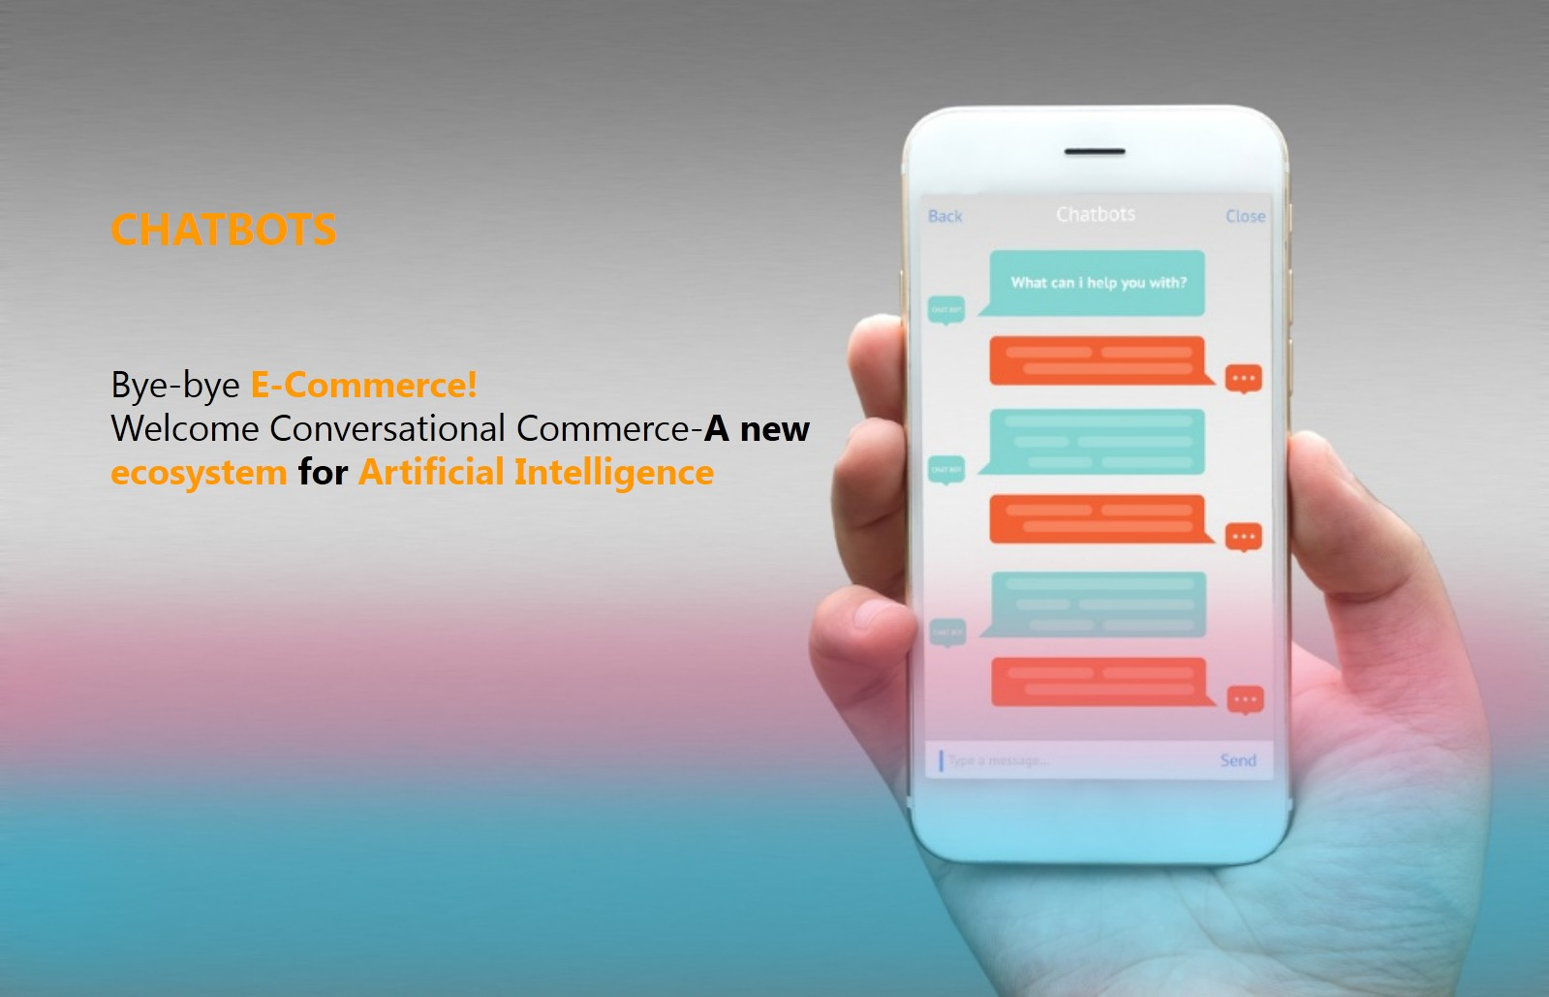


A Boutique Company that provides Training and Consulting services on Data + AI + IoT Workloads
www.jumpstartninja.com

Slide 4


Conversational Commerce - Practice Head
Known as “Bot Star” in Startup Ecosystem @ Chennai – Champion in building bot for brands in Retail, Government, Legal, Customer Care and Education. Training & Education the world in this nascent field of Conversational Commerce thro – Workshops, Seminars, Blogs and Consulting Engagements
Certified from MIT on “Data Science and Big Data Analytics: Making Data-Driven Decisions”
Microsoft Award Winner for his Contribution made to Dot Net User Group
http://www.thehindubusinessline.com/2003/06/19/stories/2003061902141700.htm
Microsoft Community Star
18 years of experience on Microsoft Tech Stack.8 Years of Experience with Architecting / Designing Enterprise solutions using Microsoft Tech stack. Very early adopter of Azure and Bot Framework + related components
Experience
Awards
Expert facilitator and corporate trainer with 5 years of experience in designing programs, content development , Chat bot, Cognitive Services, Data Analytics and Machine Learning & AI .
Currently working as Chat Bot & Conversational Commerce Practice Head - Helping customers in building their brands using messaging apps in various industry groups.
Training
Role
Srikar Kumar Bhaskara

Slide 5

About Me
Advanced Analytics Specialist.
Certified from MIT on ‘Advanced Analytics and Big Data Challenges’. Technology Enthusiast and Data Specialist.
• Microsoft Certified Power BI Developer. • Microsoft Certified Azure Machine Learning Developer from Microsoft Virtual Academy • Certified on Practical Data Analytics with Microsoft Cortana Intelligence Suite.
7.5 years of total experience as Data Specialist and Data Engineer.
Certifications
Experience
Currently working as Azure Data Specialist and Enterprise Trainer on Azure Data Analytics , Cortana Intelligence Suite and Cognitive Sciences
Expert facilitator and corporate behavioral trainer with 5 years of experience in designing programs, content development , Data Analytics and Machine Learning.
Role
Training
Sri Nag Sashank
Hosted many webinars and corporate workshops on Azure Data Analytics & Machine Learning.

Slide 6
How it Works: Convolutional Neural Networks

Slide 7
Object Detection History

Slide 8
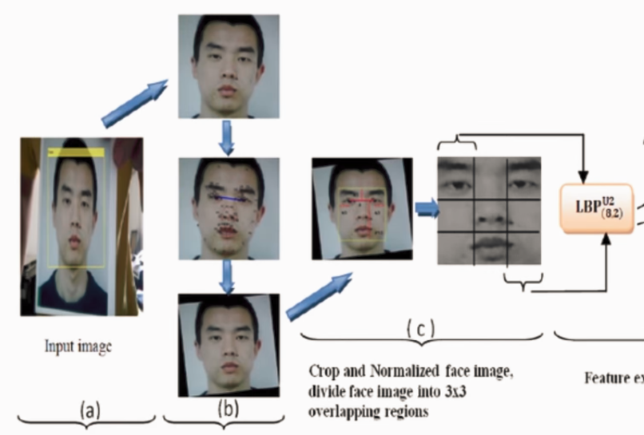
The first efficient Face Detector (Viola-Jones Algorithm, 2001)

Slide 9
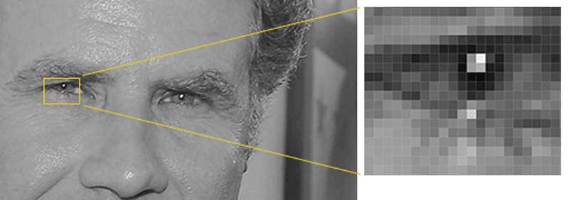
Much more efficient detection technique (Histograms of Oriented Gradients, 2005)

Slide 10


Slide 11


Slide 12
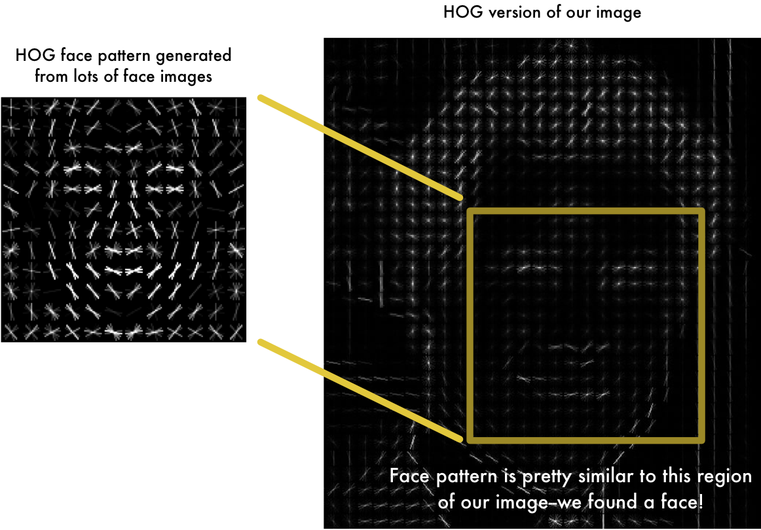

Slide 13
The Deep Learning Era begins (2012)

Slide 14
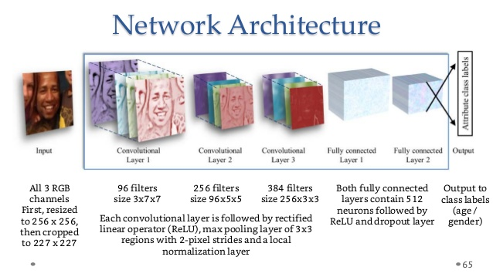

Slide 15
A toy ConvNet: X’s and O’s
Says whether a picture is of an X or an O
A two-dimensional
array of pixels
CNN
X or O

Slide 16
For example
CNN
X
CNN
O

Slide 17
Trickier cases
CNN
X
translation
scaling
rotation
weight
CNN
O

Slide 18
Deciding is hard
?
=

Slide 19
What computers see
?
=

Slide 20
What computers see

Slide 21
Computers are literal
=
x

Slide 22
ConvNets match pieces of the image
=
=
=

Slide 23
Features match pieces of the image

Slide 29
Filtering: The math behind the match

Slide 30


Slide 31
Filtering: The math behind the match
Line up the feature and the image patch.
Multiply each image pixel by the corresponding feature pixel.
Add them up.
Divide by the total number of pixels in the feature.

Slide 32
Filtering: The math behind the match
1 x 1 = 1

Slide 33
Filtering: The math behind the match
1 x 1 = 1

Slide 34
Filtering: The math behind the match
-1 x -1 = 1

Slide 35
Filtering: The math behind the match
-1 x -1 = 1

Slide 36
Filtering: The math behind the match
-1 x -1 = 1

Slide 37
Filtering: The math behind the match
1 x 1 = 1

Slide 38
Filtering: The math behind the match
-1 x -1 = 1

Slide 39
Filtering: The math behind the match
-1 x -1 = 1

Slide 40
Filtering: The math behind the match
-1 x -1 = 1

Slide 41
Filtering: The math behind the match
1 x 1 = 1

Slide 42

Filtering: The math behind the match
$$\frac{1+1+1+1+1+1+1+1+1}{9}=1$$

Slide 43
Filtering: The math behind the match
1 x 1 = 1

Slide 44
Filtering: The math behind the match
-1 x 1 = -1

Slide 45
Filtering: The math behind the match

Slide 46

Filtering: The math behind the match
$$\frac{1+1−1+1+1+1−1+1+1}{9}=.55$$
.55

Slide 47
Convolution: Trying every possible match

Slide 48
Convolution: Trying every possible match
=

Slide 49
=
=
=

Slide 50
Convolution layer
One image becomes a stack of filtered images

Slide 51
Convolution layer
One image becomes a stack of filtered images

Slide 52
Pooling: Shrinking the image stack
Pick a window size (usually 2 or 3).
Pick a stride (usually 2).
Walk your window across your filtered images.
From each window, take the maximum value.

Slide 53
Pooling
maximum

Slide 54
Pooling
maximum

Slide 55
Pooling
maximum

Slide 56
Pooling
maximum

Slide 57
Pooling
maximum

Slide 58
Pooling
max pooling

Slide 60
Pooling layer
A stack of images becomes a stack of smaller images.

Slide 61
Normalization
Keep the math from breaking by tweaking each of the values just a bit.
Change everything negative to zero.

Slide 62
Rectified Linear Units (ReLUs)

Slide 63
Rectified Linear Units (ReLUs)

Slide 64
Rectified Linear Units (ReLUs)

Slide 65
Rectified Linear Units (ReLUs)

Slide 66
ReLU layer
A stack of images becomes a stack of images with no negative values.

Slide 67
Layers get stacked
The output of one becomes the input of the next.
Convolution
ReLU
Pooling

Slide 68
Deep stacking
Layers can be repeated several (or many) times.
Convolution
ReLU
Convolution
ReLU
Pooling
Convolution
ReLU
Pooling

Slide 69
Fully connected layer
Every value gets a vote

Slide 70
Fully connected layer
Vote depends on how strongly a value predicts X or O
X
O

Slide 71
Fully connected layer
Vote depends on how strongly a value predicts X or O
X
O

Slide 72
Fully connected layer
Future values vote on X or O
X
O

Slide 73
Fully connected layer
Future values vote on X or O
X
O

Slide 74
Fully connected layer
Future values vote on X or O
X
.92
O

Slide 75
Fully connected layer
Future values vote on X or O
X
.92
O

Slide 76
Fully connected layer
Future values vote on X or O
X
.92
O
.51

Slide 77
Fully connected layer
Future values vote on X or O
X
.92
O
.51

Slide 78
Fully connected layer
A list of feature values becomes a list of votes.
X
O

Slide 79
Fully connected layer
These can also be stacked.
X
O

Slide 80
Putting it all together
A set of pixels becomes a set of votes.
.92
X
Convolution
ReLU
Fully
connected
Fully
connected
Convolution
ReLU
Convolution
ReLU
Pooling
Pooling
O
.51

Slide 81
Learning
Q: Where do all the magic numbers come from?
Features in convolutional layers
Voting weights in fully connected layers
A: Backpropagation

Slide 82
Backprop
Error = right answer – actual answer
.92
X
Convolution
ReLU
Fully
connected
Fully
connected
Convolution
ReLU
Convolution
ReLU
Pooling
Pooling
O
.51

Slide 83
Backprop
.92
X
Convolution
ReLU
Fully
connected
Fully
connected
Convolution
ReLU
Convolution
ReLU
Pooling
Pooling
O
.51

Slide 84
Backprop
.92
X
Convolution
ReLU
Fully
connected
Fully
connected
Convolution
ReLU
Convolution
ReLU
Pooling
Pooling
O
.51

Slide 85
Backprop
.92
X
Convolution
ReLU
Fully
connected
Fully
connected
Convolution
ReLU
Convolution
ReLU
Pooling
Pooling
O
.51

Slide 86
Backprop
.92
X
Convolution
ReLU
Fully
connected
Fully
connected
Convolution
ReLU
Convolution
ReLU
Pooling
Pooling
O
.51

Slide 87
Backprop
.92
X
Convolution
ReLU
Fully
connected
Fully
connected
Convolution
ReLU
Convolution
ReLU
Pooling
Pooling
O
.51

Slide 88
Gradient descent
For each feature pixel and voting weight, adjust it up and down a bit and see how the error changes.
error
weight

Slide 89
Gradient descent
For each feature pixel and voting weight, adjust it up and down a bit and see how the error changes.
error
weight

Slide 90
Hyperparameters (knobs)
Convolution
Number of features
Size of features
Pooling
Window size
Window stride
Fully Connected
Number of neurons

Slide 91
Architecture
How many of each type of layer?
In what order?

Slide 92
Not just images
Any 2D (or 3D) data.
Things closer together are more closely related than things far away.

Slide 93
Images
Columns of pixels
Rows of pixels

Slide 94
Sound
Time steps
Intensity in each
frequency band

Slide 95
Text
Position in
sentence
Words in
dictionary

Slide 96
Limitations
ConvNets only capture local “spatial” patterns in data.
If the data can’t be made to look like an image, ConvNets are less useful.

Slide 97
Customer data
Name, age,
address, email,
purchases,
browsing activity,…
Customers

Slide 98
Rule of thumb
If your data is just as useful after swapping any of your columns with each other, then you can’t use Convolutional Neural Networks.

Slide 99
In a nutshell
ConvNets are great at finding patterns and using them to classify images.

Slide 100
Azure Cognitive Services
Notes:
Hi, I’m ___, and I’m excited to discuss Microsoft’s Cortana Intelligence Suite, and the value it can deliver to your organization.

Slide 101




Build applications that understand people
Intelligence
Vision
Speech
Language
Knowledge
Search
Cognitive Services
Computer Vision
Speaker Recognition
Text Analytics
Academic Knowledge
Bing Search API
Bot Framework
Face
Speech
Bing Speller
Entity Linking Service
Bing Image Search API
Cortana
Emotion
CRIS
Web Language Model
Knowledge Exploration Service
Bing Video Search API
Video
Linguistic Analysis
Recommendations
Bing News Search API
Language Understanding Intelligent Service
Bing Auto Suggest API
Faces, images, emotion recognition and video intelligence
Spoken language processing, speaker recognition, custom speech recognition
Natural language processing, sentiment and topics analysis, spelling errors
Complex tasks processing, knowledge exploration, intelligent recommendations
Bing engine capabilities for Web, Autosuggest, Image, Video and News
Notes:
What’s incredibly unique is the intelligence capabilities Cortana Intelligence offers, building on years of Microsoft research and innovation. These capabilities enable our customers to build intelligent systems and agents that can augment their organizational capabilities. For example, organizations can interact with customers and stakeholders in new ways and infer intent with vision, face, speech, text and sentiment analysis to customize responses and drive appropriate actions.
Microsoft Cognitive Services, a set of cloud services, APIs and SDKs that enable organizations to build intelligent systems that can see, hear, interpret and understand the world around you and makes all applications more intelligent, engaging and discoverable. Cognitive Services expands the existing perceptual intelligence capabilities like Vision, Speech, Text and Face detection to include new cognitive capabilities such as Emotion and customized Language Understanding. What we showcased with www.how-old.net is one example of what is possible.
Why choose these APIs? They work, and it’s easy.
Easy: The APIs are easy to implement because of the simple REST calls. Being REST APIs, there’s a common way to implement and you can get started with all of them for free simply by going to one place, one website, www.microsoft.com/cognitive. (You don’t have to hunt around to different places.)
Flexible: We’ve got a breadth of intelligence and knowledge APIs so developers will be able to find what intelligence feature they need; and importantly, they all work on whatever language, framework, or platform developers choose. So, devs can integrated into their apps—iOS, Android, Windows—using their own tools they know and love (such as python or node.js, etc.).
Tested: Tap into an ever-growing collection of powerful AI algorithms developed by experts. Developers can trust the quality and expertise build into each API by experts in their field from Microsoft’s Research organization, Bing, and Azure machine learning and these capabilities are used across many Microsoft first party products such as Cortana, Bing and Skype.
T: Next, Bot Frameworks.

Slide 102
Vision
From faces to feelings, allow your apps to understand images and video
Computer Vision API
Face API
Emotion API
Video API
Distill actionable information from images
Detect, identify, analyze, organize, and tag faces in photos
Personalize experiences with emotion recognition
Analyze, edit, and process videos within your app
Notes:
Vision
Computer Vision API: as a free trial on the website microsoft.com/cognitive. There are also SDKs and Samples available on GitHub or through NuGet, Maven, and Cocoapods for select platforms to make development easier. It’s important to note here that it’s not client side running code, but light wrappers around the REST calls to make integration easy.
A photo app would use this as a way to tag user photos and make it easier for users to search through their collections. An assistive app would use this as a way to describe the surroundings to visually-impaired users. Works really well on both indoor or outdoor images; it can recognize common household objects, and it can describe outdoor scenes. However, we did not train on aerial images (say from drones), or on many close ups (so pictures where we zoomed in extremely on the subject won't do well). We also do really well recognizing celebrities (as long as most of the face is visible, and they were facing the camera).
Face API: Some potential uses for this technology include facial login, photo tagging, and home monitoring. Or attribute detection to know age, gender, facial hair, etc.
Emotion API: is available in the Azure marketplace, as a free trial on the website microsoft.com/cognitive. See Computer Vision description.
Build an app that responds to moods. Using facial expressions, this cloud-based API can detect happiness, neutrality, sadness, contempt, anger, disgust, fear, and surprise. The AI understands these emotions based on universal facial expressions, and it functions cross-culturally, so your app will work around the world. Some use cases would be an advertising company wants to test user response to an ad, a tv studio wants to track responses to a pilot.
Video API: as a free trial on the website microsoft.com/cognitive. See Computer Vision description.
It brings Microsoft state of the art video processing algorithms to developers. With Video API, developers can analyze and automatically edit videos, including stabilize videos, create motion thumbnails, track faces, and detect motion. Use cases: For Stabilization: If you have multiple action videos, you can use the stabilization algorithm to make them less shaky and easier to watch. You can also use the stabilization algorithm as a first step in performing other video APIs. For Face Tracking: You can track faces in a video to do A/B testing in a retail setting. You can combine Video API Face Tracking with capabilities in Face API to search through surveillance, crime, or media footage to look for certain person. For Motion Detection: Instead of having to watch long clips of surveillance footage, the API will let you know what time motion occurred and its duration. For Video Thumbnail: Take a long video, such as a keynote presentation, and automatically create a short preview clip of the talk. For Face Tracking: Works best for frontal faces. Currently cannot detect small faces, side or partial faces. For Motion Detection: Detects motion on a stationary background (e.g. fixed camera). Current limitations of the algorithms include night vision videos, semi-transparent objects, and small objects. For Video Thumbnail: Take a long video, such as a keynote presentation, and automatically create a short preview clip of the talk.

Slide 103

Computer Vision APIs
Analyze an image Understand content within an image
OCR Detect and recognize words within an image
Generate thumbnail Scale and crop images, while retaining key content
Recognize Celebrities Thanks to domain specific models, ability to recognize 200K celebrities from business, politics, sports and entertainment around the World.
Notes:
Do you need an API that gives you actionable information about images used in your app? The Computer Vision API gives you the tools to understand the contents of any image. Create tags identifying objects, beings, or actions present in the image, and then craft coherent sentences to describe it. Whether you want to execute better image search, or you want to create an assistive app for the visually impaired, the Computer Vision API helps get the job done.

Slide 104
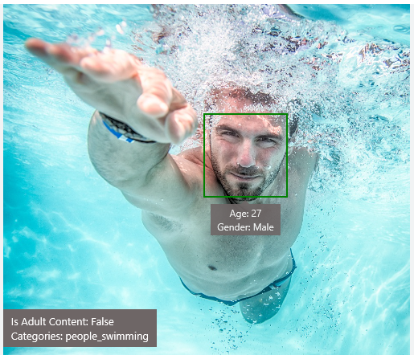
Analyze image
Type of image
Clip Art Type 0 Non-clipart
Line Drawing Type 0 Non-Line Drawing
Black & White Image False
Content of image
Categories [{ “name”: “people_swimming”, “score”: 0.099609375 }]
Adult Content False
Adult Score 0.18533889949321747
Faces [{ “age”: 27, “gender”: “Male”, “faceRectangle”: {“left”: 472, “top”: 258, “width”: 199, “height”: 199}}]
Image colors
Dominant Color Background White
Dominant Color Foreground Grey
Dominant Colors White
Accent Color

Slide 105

OCR
Good at
JSON:
{
"language": "en",
"orientation": "Up",
"regions": [
{
"boundingBox": "41,77,918,440",
"lines": [
{
"boundingBox": "41,77,723,89",
"words": [
{
"boundingBox": "41,102,225,64",
"text": "LIFE"
},
{
"boundingBox": "356,89,94,62",
"text": "IS"
},
{
"boundingBox": "539,77,225,64",
"text": "LIKE"
}
. . .
Scanned documents
Photos with text
Fine grained location information
LIFE IS LIKE
RIDING A BICYCLE
TO KEEP YOUR BALANCE
YOU MUST KEEP MOVING

Slide 106




Smart thumbnail
Smart cropping on
Smart cropping off

Slide 107

Recognize emotions Detect emotions based on facial expressions in photos and videos
Emotion APIs
Notes:
How are you feeling? Can your app tell? With the Emotion API, you can build an app that recognizes emotions according to facial expressions—giving you the capability to provide an amazing, personalized experience.
Using facial expressions, this cloud-based API can detect happiness, neutrality, sadness, contempt, anger, disgust, fear, and surprise. The AI understands these emotions based on universal facial expressions, and it functions cross-culturally, so your app will work around the world.

Slide 108
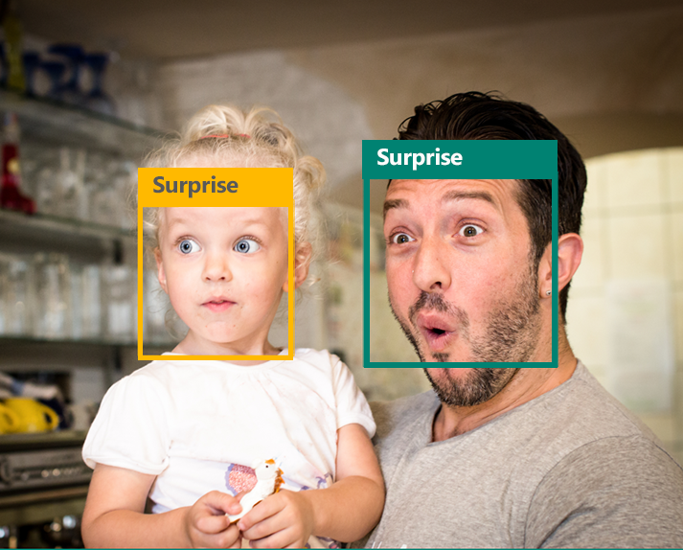
Emotion APIs
Face detection
"faceRectangle": {"width": 193, "height": 193, "left": 326, "top": 204} …
Emotion scores
“scores": { "anger": 5.182241e-8,
"contempt": 0.0000242813,
"disgust": 5.621025e-7,
"fear": 0.00115027453,
"happiness": 1.06114619e-8,
"neutral": 0.003540177,
"sadness": 9.30888746e-7,
"surprise": 0.9952837}

Slide 109

Face APIs
Face detection Detect faces and their attributes within an image
Face verification Check if two faces belong to the same person
Similar face searching Find similar faces within a set of images
Face grouping Organize many faces into groups
Face identification Search which person a face belongs to
Notes:
Detect human faces and compare similar ones, organize people into groups according to visual similarity, and identify previously tagged people in images.

Slide 110




Face APIs
Detection
"faceRectangle": {"width": 193, "height": 193, "left": 326, "top": 204}
…
Feature attributes
"attributes": { "age": 42, "gender": "male",
"headPose": { "roll": "8.2", "yaw": "-37.8", "pitch": "0.0" }}
Grouping
Identification
Jasper Williams

Slide 111


Video APIs
Stabilization Smooth and stabilize shaky video
Face detection and tracking Detect and track faces in videos
Motion detection Detect when motion occurs
Notes:
Intelligent video processing produces stable video output, detects motion, creates intelligent thumbnails, and detects and tracks faces.

Slide 112
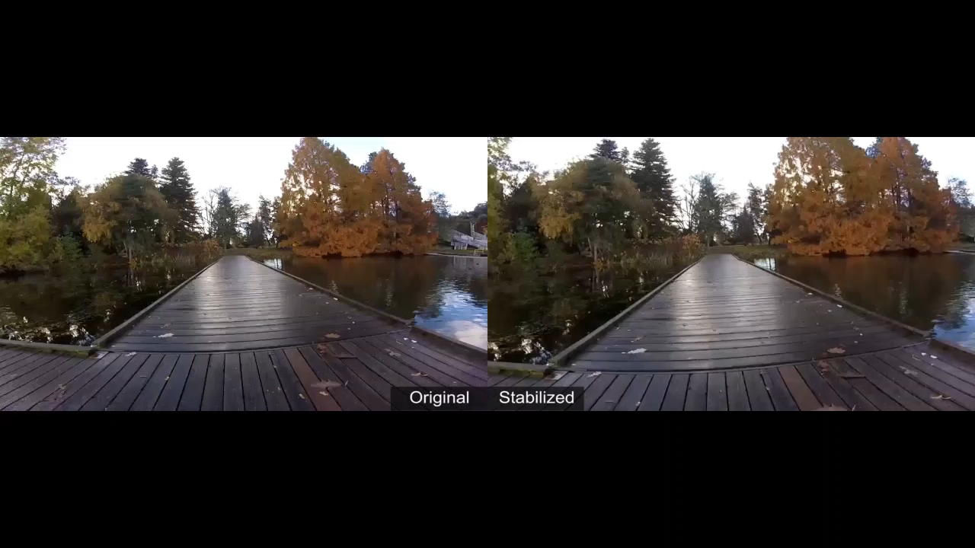
Stabilization
The Stabilization API provides automatic video stabilization and smoothing for shaky videos
This API uses many of the same technologies found in Microsoft Hyperlapse
Best For: Small camera motions, with or without rolling shutter effects (e.g., holding a static camera, walking with a slow speed)

Slide 113
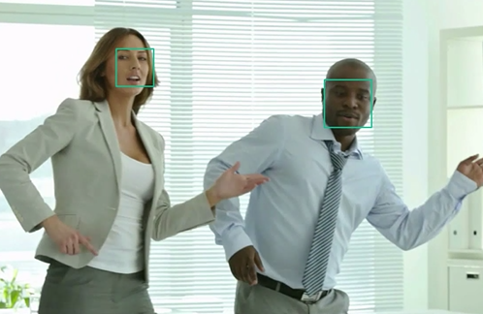
Face detection and tracking
High precision face location detection and tracking
Can detect up to 64 human faces in a video (no smaller than 24x24 pixels)
Detected and tracked faces are returned with coordinates and a Face ID to track throughout the video
Time (sec) | Face ID | x, y | Width, height
0 | 0 | 0.59, 0.23 | 0.09, 0.16
0 | 1 | 0.38, 0.15 | 0.07, 0.12
1 | 0 | 0.54, 0.25 | 0.09, 0.15
1 | 1 | 0.23, 0.18 | 0.07, 0.12

Slide 114
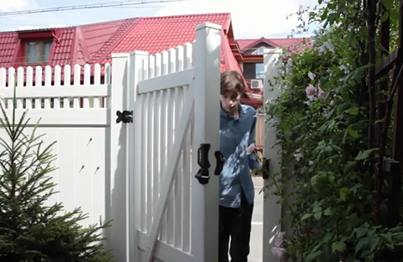
Motion detection
Indicates when motion occurs against a fixed background (e.g., surveillance video)
Trained to reduce false alarms, such as lighting and shadow changes
Current limitations:
No support for night-vision videos
Semi-transparent and small objects are not detected well
Start time | End time | In region
1.9 | 3.6 | 0
5.2 | 15.1 | 0

Slide 115
Speech
Hear and speak to your users by filtering noise, identifying speakers, and understanding intent
Bing Speech API
Speaker Recognition API
Custom Recognition Intelligent Service
Convert speech to text and back again, and understand its intent
Give your app the ability to know who's talking
Fine-tune speech recognition for anyone, anywhere
Notes:
Speech APIs provide state-of-the-art algorithms to process spoken language powered by Bing. This also includes speech synthesis for a subset of languages supported by speech recognition. With these APIs developers can easily include the ability to add speech driven actions into their applications. In certain cases, the APIs allow for real-time interaction with the user as well. Additional capabilities include voice recognition and speaker identification as well as providing partial transcription, meaning that for supported languages the developer can get partial results before the user has finished speaking. The initial release supports 7 languages.
Bing Speech API: At the time of publication, this data was not available. Please email Rebecca Duffy, reduffy@microsoft.com, if you would like more information.
We also have SDKs available for Speech.
CRIS: The Custom Recognition Intelligent Service (CRIS) enables you to create customized language models and acoustic models tailored to your application and your users. By uploading speech and/or text data to CRIS that reflects your application and your users, you can create custom models that can be used in conjunction with Microsoft’s existing state-of-the-art speech models. To customize the acoustic model to a particular domain, a collection of speech data is required. This collection consists of a set of audio files of speech data, and a text file of transcriptions of each audio file. The audio data should be representative of the scenario in which you would like to use the recognizer. If you were building an app to search MSDN by voice, it’s likely that terms like “object-oriented” or “namespace” or “dot net” will appear more frequently than in typical voice applications. Customizing the language model will enable the system to learn this. CRIS uses acoustic or language model adaptation to enable the speech recognizer to learn the characteristics of the customer’s data while still getting the benefits of all the data and expertise that went into creating the base models that power the Speech API.
For acoustic model adaptation, the technology is described in this paper: http://research.microsoft.com/pubs/194346/0007893.pdf
Works well when the data is uploaded to CRIS is truly representative of the user population and the expected usage of the application. For language model adaptation, it works best when the data uploaded reflects what people would actually say. Uploading simply a list of new terms is better than nothing but will not be as effective. For acoustic model adaptation, if you want to adapt to elderly speech, you need to upload the speech from many different elderly users, not just one or two. If you upload just one person’s voice, CRIS will learn to do a great job on that voice but will not necessarily learn to generalize to other elderly voices. Similarly, if you want to adapt to a new environment, like a factory, you should upload speech data from many speakers in the factory, not just one.
Speaker Recognition API: Microsoft's state-of-the-art cloud-based speaker recognition algorithms to recognize a human's voice in audio streams. It comprises two components: speaker verification and speaker identification. Speaker Verification can automatically verify and authenticate users from their voice or speech. It is tightly related to authentication scenarios and is often associated with a pass phrase. Hence, we opt for text-dependent approach, which means speakers need to choose a specific pass phrase to use during both enrollment and verification phases. Speaker Identification can automatically identify the person speaking in an audio file given a group of prospective speakers. The input audio is paired against the provided group of speakers, and in case there is a match found, the speaker’s identity is returned. It is text-independent, which means that there are no restrictions on what the speaker says during the enrollment and recognition phases. A use case is biometric authentication using voice.
https://blogs.technet.microsoft.com/machinelearning/2015/12/14/now-available-speaker-video-apis-from-microsoft-project-oxford/
We also have SDKs available for Speaker Reco

Slide 116

Speech APIs
Voice recognition (speech to text) Converts spoken audio to text
Voice output (text to speech) Synthesize audio from text
Speech intent recognition Convert spoken audio to intent
Notes:
Convert audio to text, understand intent, and convert text back to speech for natural responsiveness.
Speech Intent Recognition can, in addition to returning recognized text from audio inputs, also return structured information about the speech to apps that parse the intent of the speaker and drive further actions by the app. Models trained by LUIS service are used to generate the intent.

Slide 117
Voice recognition
REST API
Client library
SUPPORTED PLATFORMS
Any
Windows, Android, iOS
DATA SUPPORT
Yes
Yes
MIC SUPPORT
No
Yes
SILENCE DETECTION ON MIC
No
Yes
LENGTH OF UTTERANCE
Short
Short and long
NUMBER OF RESPONSES
n-best response back
Multiple partial results, n-best (short), and multiple phrases (long)
Supports 7 languages: en-US, en-GB, zh-CN, it-IT, fr-FR, es-ES, de-DE
Same technology that supports Microsoft offerings of Xbox, Windows, and Cortana

Slide 118
Voice recognition
Short form
Long form
Duration of Audio | < 15 seconds | < 2 minutes
Final Result | n-best choice | Best choice, delivered at sentence pauses
Partial Results | Yes | Yes
450 6th St. San Francisco
********* Final N-BEST Results *********
[0] Confidence=Normal Text="450 six St San Francisco."
[1] Confidence=Normal Text="For 50 six St San Francisco."
[2] Confidence=Normal Text="456th St San Francisco."
[3] Confidence=Normal Text="450 six St in San Francisco."
[4] Confidence=Normal Text="456 St San Francisco."

Slide 119
Voice output
Synthesize audio from text via POST request
Maximum audio return of 15 seconds
17 languages supported
<speak version="1.0" xmlns="http://www.w3.org/2001/10/synthesis" xmlns:mstts="http://www.w3.org/2001/mstts" xml:lang="en-US">
<voice name="Microsoft Server Speech Text to Speech Voice (en-US, ZiraRUS)">
Synthesize audio from text, to speak to your users.
</voice></speak>
Synthesize audio from text, to speak to your users

Slide 120

Custom Recognition
Customize both language and acoustic models Tailor speech recognition to your app and environment
Notes:
Eliminate speech recognition barriers like speaking style, background noise, and vocabulary.
Does your speech recognition work with varied user populations, vocabularies, or with background noise? The Custom Recognition Intelligent Service (CRIS) helps you create custom speech recognition endpoints—so accents and environments are features, not challenges.
Customize your speech recognition by vocabulary and speaking style, create custom acoustic models to match the expected environment of your users, and tap into the API's powerful intelligence to create speech recognition endpoints customized to your app's needs. Turn language barriers into features with CRIS.

Slide 121
Custom Recognition Intelligent Service
Create custom language models for the vocabulary of the application
Adapt acoustic models to better match the expected environment of the application’s users
Deploy to a custom endpoint and access from any device
Record
audio
Adapt
Deploy
Transcribe

Slide 122
Speaker recognition API
“”
Speaker verification Check if two voices are the same
Speaker identification Identify who is speaking
Notes:
Your users' voices are their passports with the Speaker Recognition API. Your app can authenticate identities by using someone's voice, giving your users the capability to interact securely through speech.

Slide 123
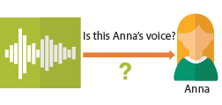
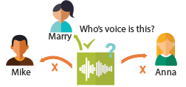
Speaker recognition APIs
“”
Enrollment
Create a unique voiceprint for a profile
Is this Anna’s voice?
Recognition
After enrolling one or more voices, identify who is speaking from an audio clip
Anna
Verification
Who’s voice is this?
Confirm if a voice belongs to a previously enrolled profile
Marry
Mike
Anna

Slide 124




Speech
Language
Process text and learn how to recognize what users want
Bing Spell Check API
Web Language Model API
Linguistic Analysis API
Language Understanding Intelligent Service
Text Analytics API
Detect and correct spelling mistakes within your app
Leverage the power of language models trained on web-scale data
Easily parse complex text with language analysis
Teach your apps to understand commands from your users
Detect sentiment, key phrases, topics, and language from your text
Notes:
Bing Spell Check API: Microsoft’s state-of-the-art cloud-based spelling algorithms to detect a wide variety of spelling errors and provide accurate suggestions. Using Bing Spell Check, your mobile and PC apps will be powered with state-of-the-art spelling capabilities. Our service is trained on a massive corpus of data gleaned from billions of web pages. There is no need to train your own models. The speller model is updated regularly and incorporates new terms and brands almost as quickly as they appear on the web. This API is available through Microsoft Cognitive Services for customers with low-volume and high-latency jobs. For high-volume and low-latency we have an internal API which may be more suitable. Contact donaldbr directly for more information.
Use cases: 1) Improve the quality of a website's product search 2) provide spell correction for a keyboard app 3) provide spell correction for text fields in an app or web page 4) detect errors in UI text and user data. See https://blogs.msdn.microsoft.com/msr_er/2010/12/15/building-a-better-speller-bing-and-microsoft-research-offer-prizes-for-best-search-engine-spelling-alteration-services/ The speller is exceptional at common spelling errors with low edit-distance (such as febuary->February) but a lot of other spellers are good at that as well. We Do a very good job with word breaking, proper names in context (try "director stephen spielberg") and fictional character names, just a few examples. Areas that are a challenge are capitalization (we don't know what to do with "March" for example, even with context) and consistency (there are times when we will flag a word only intermittently based on the context).
Web Language Model API: Web Language API indexes the web and Bing queries to allow users to calculate the probabilities of natural language expressions and estimate a list of most likely words to follow an existing sequence of words. Use this API to insert spaces into a string of words without spaces, like a hashtag or URL. Use this API to rerank machine translation/speech recognition candidate sentences based on probability of the sentence.
Use this API for academic research. http://research.microsoft.com/apps/pubs/default.aspx?id=130762
We also have SDKs available for WebLM
Linguistic Analysis API: The Linguistic Analysis API helps you gain insights from text. Given a natural language parse, it’s easy to identify the concepts and entities (noun phrases), actions (verbs and verb phrases), descriptive words, and more. The processed text can provide useful features for classification tasks such as sentiment analysis.
We also have SDKs available for Linguistic Analysis.
LUIS: Language Understanding Intelligent Service (LUIS) allows developers to build a model that understands natural language and commands tailored to their application. Example: You can say “turn down the thermostat in the living room,” send it to a LUIS model, and instead of just returning the text that represents what was said, LUIS will return: the action is “turn down,” the location is “living room,” and the target is “thermostat.” LUIS allows developers to iteratively build on these models and take speech or text input and return a structured representation of what the person said. Not only that but by build LUIS will help developers create and train smart conversational bot (Intercom or Slack) with a single button. LUIS will also offer action fulfillment capabilities by simple integration with webhooks. LUIS works pretty well it comes to intents. For the entities, the learning curve is slower especially when the number of entities increases. LUIS only supports 20 intents & 10 entities yet by build each entities can have up to 10 children.
Text Analytics API: At the time of publication, this data was not available. Please email Rebecca Duffy, reduffy@microsoft.com, if you would like more information.

Slide 125

Bing spell check APIs
State-of-the-art cloud based spelling algorithms Recognizes a wide variety of spelling errors
Recognize name errors and homonyms in context Difficult to spot errors that use the context of the words around them
Updates over time Support for new brands and coined expressions as they emerge
Notes:
The Bing Spell Check API corrects spelling errors, contextually recognizes names and slang, understands homonyms, and supports brand names.

Slide 126

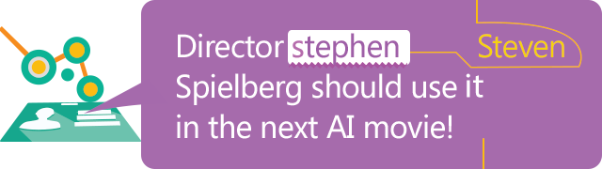

Bing spell check APIs
Check a single word or a whole sentence
“Our engineers developed this four you!”
Corrected Text: “four” → “for”
Identify errors and get suggestions
"spellingErrors": [
{
"offset": 5,
"token": "gona",
"type": "UnknownToken",
"suggestions": [
{ "token": "gonna" }
] }

Slide 127

Language Understanding
Understand what your users are saying Use pre-built Bing and Cortana models or create your own
Notes:
Understand language contextually, so your app communicates with people in the way they speak.
Do your apps understand language in the way people speak it—contextually? With the Language Understanding Intelligent Service (LUIS) API, you can integrate language models that understand your users quickly and easily. And if one of our preexisting models won't work, it will guide you through building your own.
Prebuilt models will recognize places, times, numbers, and temperatures, and handle common requests like "set an alarm for 8 AM." LUIS supports dialogue and action fulfillment, so your users can carry on a conversation with your app. For example, the input "schedule a meeting with Allison" results in the question "when?," allowing the user to respond "3 PM," and the meeting gets scheduled.

Slide 128
Language understanding intelligent service
Reduce labeling effort with interactive featuring
Use visualizations to gauge performance and improvements
Leverage speech recognition with seamless integration
Deploy using just a few examples with active learning
Define
concepts
Provide
examples
Deploy
Active learning

Slide 129
Language understanding models
{
“entities”: [
{
“entity”: “flight_delays”,
“type”: “Topic”
}
],
“intents”: [
{
“intent”: “FindNews”,
“score”: 0.99853384
},
{
“intent”: “None”,
“score”: 0.07289317
},
{
“intent”: “ReadNews”,
“score”: 0.0167122427
},
{
“intent”: “ShareNews”,
“score”: 1.0919299E-06
}
]
}
“News about flight delays”

Slide 130
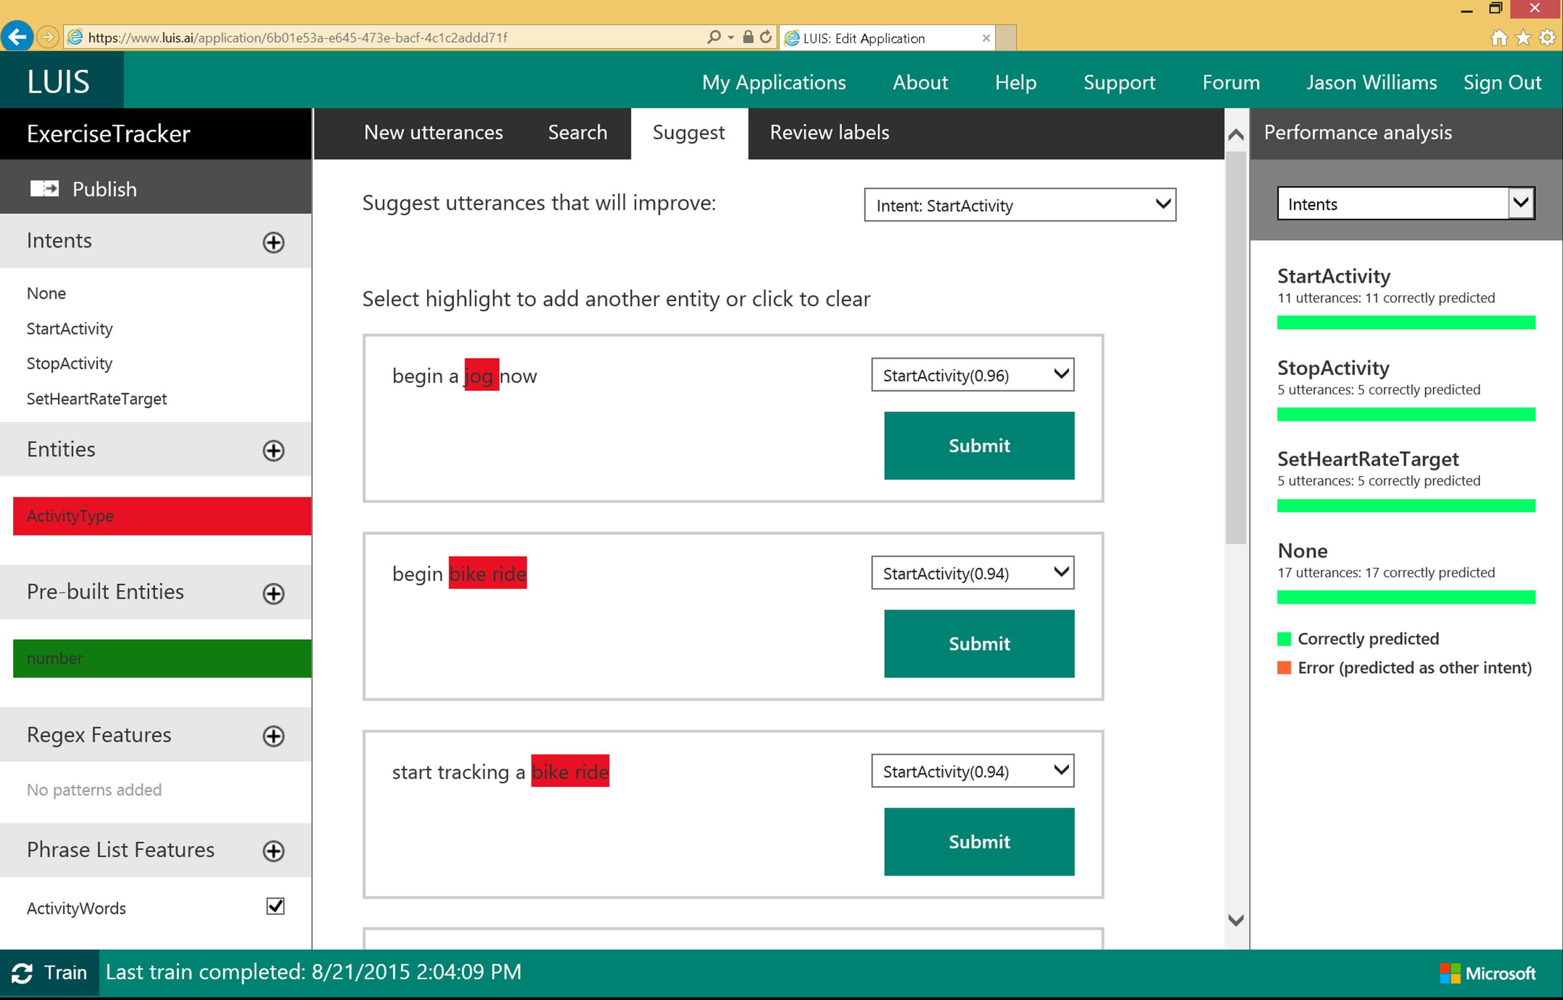

Slide 131

Linguistic analysis
Analysis tolls for natural language processing Access to part-of-speech tagging and parsing, identifying concepts, and actions
Notes:
You know what your users are saying, but do you know what it means? The Linguistic API uses advanced linguistic analysis tools for natural language processing, giving you access to part-of-speech tagging and parsing. These tools allow you to hone in on important concepts and actions. The API can tap into traditional linguistic analysis tools that allow you to identify the concepts and actions in your text with part-of-speech tagging, and find phrases and concepts using natural language parsers. Whether you’re mining customer feedback, interpreting user commands, or consuming web text, understanding the structure of the text is a critical first step. Try it out below!

Slide 132
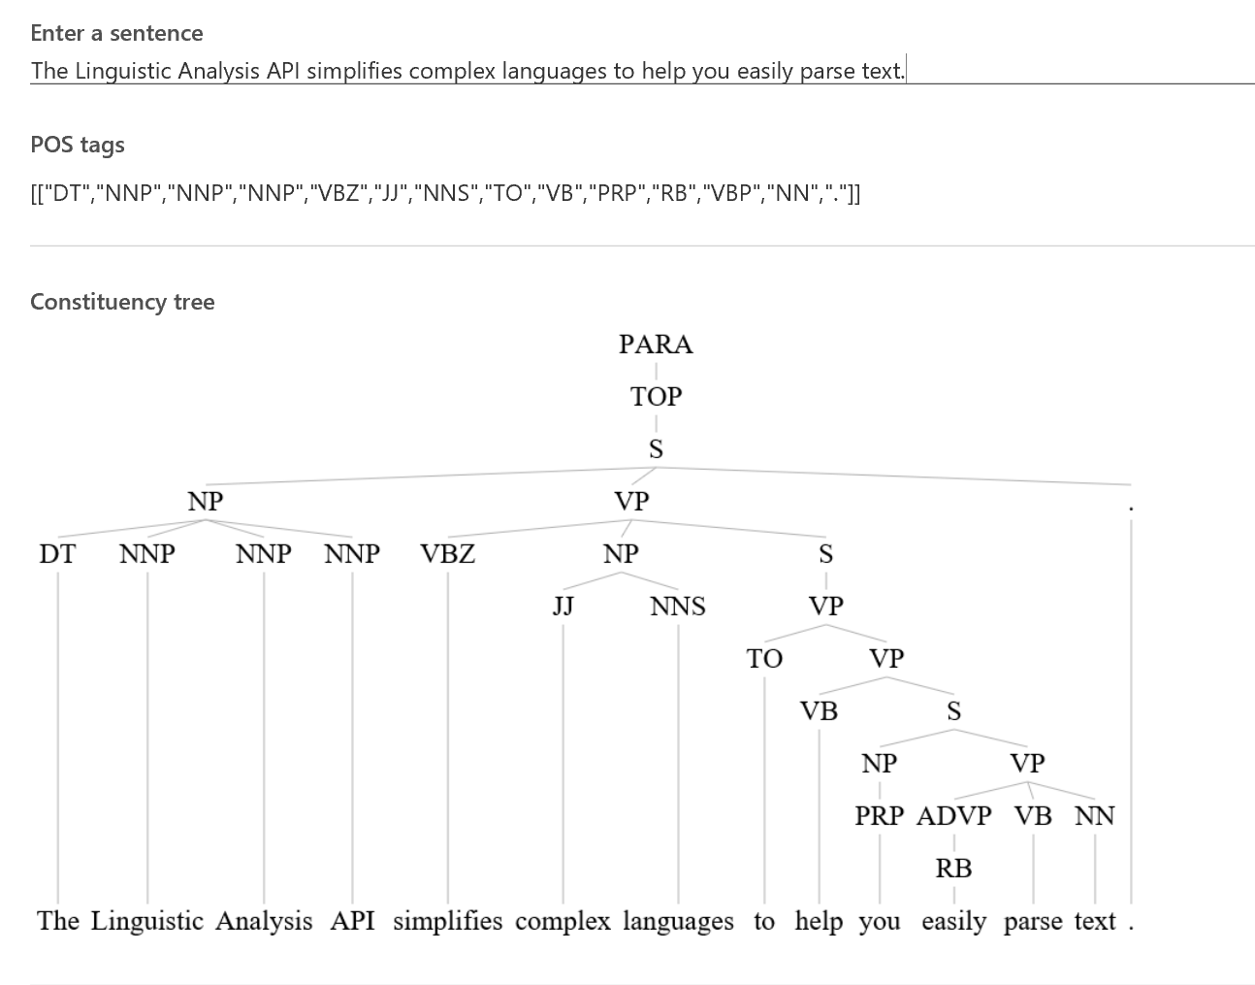
Linguistic Analysis

Slide 133

Text analytics
Sentiment analysis Understand if a record has positive or negative sentiment
Key phrase extraction Extract key phrases from a piece of text, and retrieve topics
Topic detection Use clustering techniques to identify the trending topics on a large set of text records
Language detection Identify the language, 120 supported languages
Notes:
Understanding and analyzing unstructured text is an increasingly popular field and includes a wide spectrum of problems such as sentiment analysis, key phrase extraction, topic modeling/extraction, aspect extraction and more.

Slide 134

Web language model
Automation of a variety of standard natural language processing tasks using state-of-the-art language modeling APIs
Word breaking, joint probability of natural language expressions, scoring, and predicting following words in a sequence
Notes:
Automate a variety of standard natural language processing tasks using state-of-the-art language modeling APIs.
Do you need to know how frequently certain words appear together? Or figure out which words a user might type next? Or how to break a hashtag into individual words? The Web Language Model API lets your app do all of this quickly and accuratel.

Slide 135

Language
Knowledge
Tap into rich knowledge amassed from the web, academia, or your own data
Academic Knowledge API
Knowledge Exploration Service
Entity Linking Service
Recommendations API
Explore relationships among academic papers, journals, and authors
Add interactive search over structured data to your project
Contextually extend knowledge of people, locations, and events
Provide personalized product recommendations for your customers
Notes:
Academic Knowledge API: The Academic Knowledge API enable developers to interpret user queries for academic intent and retrieve rich entity information about research papers, authors, journals, conferences, and universities from the Microsoft Academic Graph (MAG). 1. Developers can use this API to build search features such as the knowledge-based query auto-suggest and search results at http://academic.microsoft.com. 2. Universities can retrieve analytics data about their researchers' publications, topics, and venues. 3. Conference organizers can analyze the citation patterns of their conference papers. 4. Data scientists and computer science researchers can develop new ranking and analysis approaches over a large heterogeneous network.
A publication about our approach can be found here: http://research.microsoft.com/apps/pubs/default.aspx?id=246609 The underlying data graph (Microsoft Academic Graph) is constructed over discovered academic papers on the web. The data is largely unstructured, of variable quality, and ambiguous. We are constantly working to improve this data quality and to correctly aggregate the multiple instances of authors, papers, etc. into a single representative entity in the graph.
Knowledge Exploration Service API: Enable interactive search experience over structured data via natural language. Indexes customer's structured data (BYOD) with support for prefix completion. Generates annotated interpretations/completions of natural language queries. Publishers/libraries can use this to create interactive search over their publications similar to academic.microsoft.com. Merchants can create interactive search experience to help users find and discover products. Data owners can create systems that answer natural language user questions. It works best when the structured data is clean and the natural language structure is simple and predictable. Otherwise, customers will have to invest a bit of work to generate the structured data and author the grammar. We are working on future components to simplify both authoring aspects.
Entity Linking Service API: Given a specific paragraph of text within a document, the Entity Linking will recognize and identify each separate entity based on the context and linking the entity to wikipedia. Use cases: A news agency would use this to analysis their news article to create relations between articles, a news agency would use this to generate tags for article and make recommendation for reader, a company would use this to track the PR articles mentioned it and product comments to track customer feedback. We also have SDKs available for Entity Linking.
Recommendations API: At the time of publication, this data was not available. Please email Rebecca Duffy, reduffy@microsoft.com, if you would like more information.

Slide 136

Academic knowledge
Interpret Interprets a natural language user query string. Returns annotated interpretations which can enable rich search-box auto-completion experiences that anticipate what the user is typing
Evaluate Evaluates a query expression and returns academic knowledge entity results
Calchistogram Calculates a histogram of the distribution of attribute values for the academic entities returned by a query expression, such as the distribution of citations by year for a given author
Notes:
Tap into the wealth of academic content in the Microsoft Academic Graph using the Academic Knowledge API.
Do your users know who the top scholars have been in machine learning over the last three years? What about every paper authored by an expert like Li Deng from Microsoft? The Academic Knowledge API answers these and other questions by applying the Knowledge Exploration Service to the Microsoft Academic Graph. Users can start from natural language queries, or you can ping the graph directly through structured query expressions.
Additionally, the Academic Knowledge API can auto-complete natural language queries and return entity results, helping users narrow research results faster.
It can also create a histogram of attribute values for academic entries returned by a query—for example, the distribution of papers by year for an author.

Slide 137

Entity linking
Power your app's data links with named entity recognition and disambiguation A word might be used as a named entity, a verb, or another word form within a given sentence
The Entity Linking Intelligence Service will recognize and identify each separate entity based on the context
Notes:
Provide better user experiences by adding the Entity Linking Service to your app so that it can provide additional knowledge and facts from the web to supplement the text in context. The Entity Linking Service uses a prebuilt knowledge base to build links, and the option to acquire knowledge from your own data.
For example, your app may need to understand that "London, the capital" is the city of
London in the United Kingdom and not London, Ontario, or Jack London, the author.
The Entity Linking Service provides this information quickly and within context, offering a faster, more intelligent user experience.

Slide 138

Knowledge exploration Enable interactive search experiences over structured data via natural language inputs
Attribute histograms To enable rich visualization and interactive faceted experience
Structured query evaluation To efficiently retrieve detailed information about matching objects
Query auto-completion
To reduce user effort and help with discovery of rich capabilities
Natural language understanding
To interpret natural language queries into structured query expressions
Notes:
Do you have structured data for users to explore via natural language? The Knowledge Exploration Service takes structured data and linguistic resources you provide and creates a service that enables interactive search.
For example, as your users enter queries in a search box, the Knowledge Exploration Service offers auto-complete suggestions and semantic annotations. You can retrieve the top matching objects from the data, and you can create histograms of attribute values among the matches.

Slide 139


Recommendations
Increase catalog discovery Help customers easily discover items that they may be interested in
Personalize your experience Show suggestions that are targeted to each specific user
Increase the bottom line Increase your conversion rate by offering the right products at the right time
Notes:
The Recommendations API helps your customer discover items in your catalog.
Customer activity in your digital store is used to recommend items and to improve conversion in your digital store.
The recommendation engine may be trained by uploading data about past customer activity or by collecting data directly from your digital store. When the customer returns to your store you will be able to feature recommended items from your catalog that may increase your conversion rate.

Slide 140
Search
Knowledge
Access billions of web pages, images, videos, and news with the power of Bing APIs
Bing Web Search API
Bing Autosuggest API
Bing Image Search API
Bing Video Search API
Bing News Search API
Connect powerful search to your apps
Give your app intelligent autosuggest options for searches
Bring advanced image and metadata search to your app
Trending videos, detailed metadata, and rich results
Link your users to robust and timely news searches
Notes:
The Search APIs provide access to the search technology that power Bing.com and a long list of 1st-party (Office, Cortana, Xbox, Edge) and 3rd-party (AOL, Apple, Amazon, Yahoo etc.) partners. In total, we have 4 Search APIs for web, image, video and news search. In addition we provide access to our Autosuggest (type-ahead) and Spell Check services.
Bing Web Search API: is the main Search API. With one programmatic call, the user can get back relevant webpage, image, video, and news results. It's equivalent to searching in the web vertical in bing.com. The Search APIs provide the power of the Bing Search engine to developers. You get access to many of the latest and greatest capabilities the bing.com site has to offer, in the form of an API. It's the same architecture stack so it's a powerful way to bring the knowledge and intelligence of the search engine to your own experience. The API is built directly on top of the entire Bing stack- you get the quality, relevance, performance and continuous improvements that the rest of the site gets. Similar to Bing.com- tail queries, or obscure terms may have limited results. We're always working to improve the edge cases though and API users will benefit from that.
Bing Autosuggest API: At the time of publication, this data was not available. Please email Rebecca Duffy, reduffy@microsoft.com, if you would like more information.
Bing Image Search API: At the time of publication, this data was not available. Please email Rebecca Duffy, reduffy@microsoft.com, if you would like more information.
Bing Video Search API: At the time of publication, this data was not available. Please email Rebecca Duffy, reduffy@microsoft.com, if you would like more information.
Bing News Search API: At the time of publication, this data was not available. Please email Rebecca Duffy, reduffy@microsoft.com, if you would like more information.

Slide 141

Bing web search
Intelligent search to your apps with the ability to comb billions of webpages, images, videos, and news with a single API call Retrieve web documents indexed by Bing and narrow the results down with filters such as by answer type and freshness
Notes:
The Bing Search API adds intelligent search to your app, combing hundreds of billions of webpages, images, videos, and news to provide relevant results with no ad requirements. The results can be automatically customized to your users' locations or markets, increasing relevancy by staying local.

Slide 142

Bing image search
A variety of image search options, from trending images to detailed insights Scour the web for images and get results that include thumbnail and full image URLs, publishing website, image metadata, related images, and more
Notes:
The Bing Image Search API gives you powerful image searching tools with a single call. You can tap into trending images of people, places, and things from around the world, and filter results by image style, size, layout, date added, and license type.

Slide 143

Bing video search
A variety of advanced video search features, including trending videos, price, and other useful metadata Find videos from across the web and get responses that provide useful metadata including creator, encoding format, video size and quality, and source view count
Notes:
The Bing Video Search API offers robust video searching features with a single API call. You can receive information from around the world about trending videos, updated on a daily basis. Search results can be returned by either a static image or a motion thumbnail, allowing you to customize how your users see what they're looking for.

Slide 144

Bing news search
Turn any app into a news desk with world news grouped and filtered by topic, local news, and metadata you can mine
Notes:
The Bing News Search API can help turn your app into an up-to-date news center. Results from a single call bring trending news from around the world, which is updated in near-real time, so users can be kept up to date on whatever's happening in their neighborhood—or across the globe.

Slide 145

Bing auto suggest
[
Query completion suggestions capabilities, so users can type less and get to what they want faster
Notes:
Whether you're searching the web, a local set of data, or just asking users to enter an input into your app, the Bing Autosuggest API helps narrow the search quickly by allowing your users to see suggestions for popular search terms. It can correct perceived mistakes, and returns detailed contextual suggestions according to other searches people have found useful.

Slide 146
Demo
Notes:
https://www.microsoft.com/cognitive-services/en-us/documentation
https://www.microsoft.com/cognitive-services/en-us/computer-vision-api

Slide 147
Conversational Commerce
Azure Bot Service

Slide 148

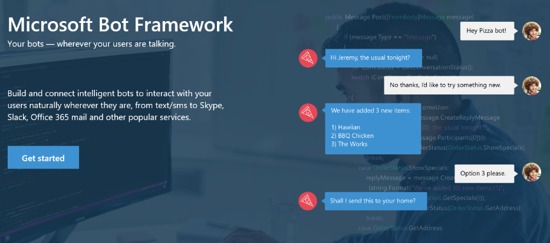
Your bots – wherever your users converse
Your Bots – where your users converse
Intelligence
Cognitive Services
Bot Framework
Cortana
Bot Connector Service: A service to register your bot, configure channels and publish to the Bot Directory. Connect your bot(s) seamlessly to text/sms, Office 365 mail, Skype, Slack, Twitter, and more.
Bot Builder SDK: An open source SDK hosted on GitHub. Everything you need to build great dialogs within your Node.js or C# bot
Bot Directory: A public directory of bots registered through the Bot Connector Service. Discover, try, and add bots to conversation experiences
Notes:
Microsoft Bot Framework enables organizations to build intelligent agents (Bots) that allow your intelligent systems to interact with your users in more contextual and natural ways, from text/sms to Office365 mail to Skype, Slack and other services. The Bot Framework provides developers with a developer portal & SDK to build your bot, a bot connector service to connect to social channels such as Twitter, Slack etc. and a bot directory to discover and use existing bots.
T: Next, Cortana.

Slide 149
Bot Framework ( Conversational Commerce )
Intelligence
Introduction
Azure Bot Service
Bot Builder
Cognitive Services
App Economy to Bot Economy
Basic
Introduction + SDKs
Bot Framework
Conversational Commerce
Form
Bot Simulator
Cortana
About Azure Bot Framework
LUIS
Bot Connectors
Industry Case Studies
Proactive
Bot Framework Portal
Q&A

Slide 150
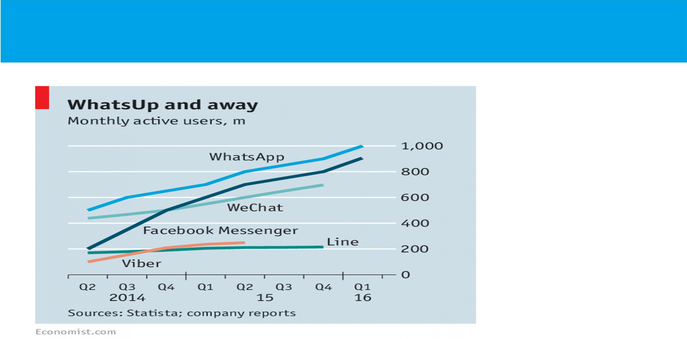




App Economy to Bot Economy

Slide 151
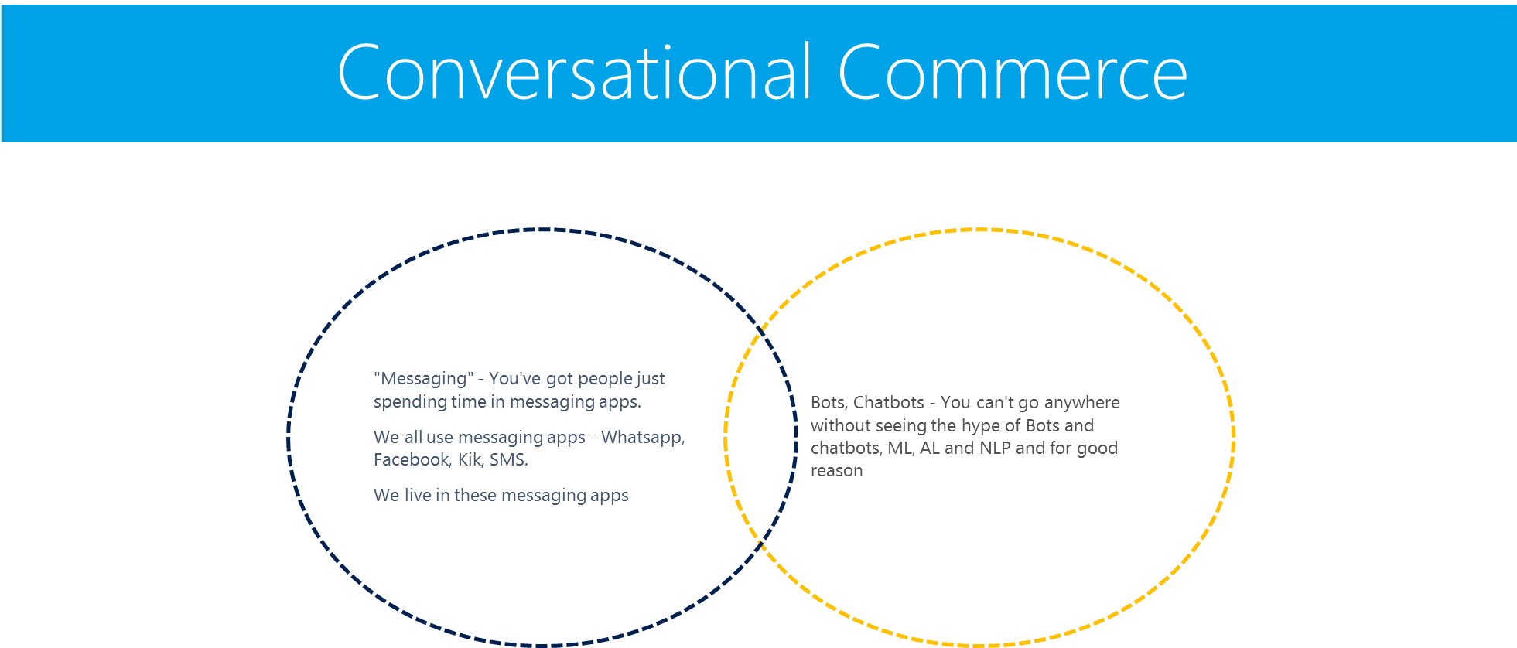

Slide 152

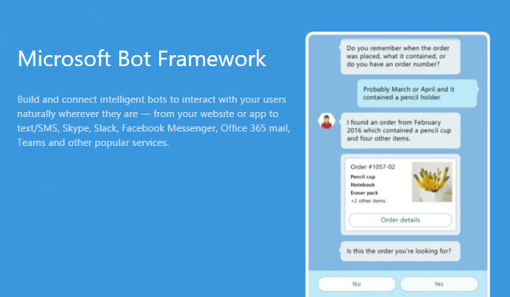
Notes:
About Bot Framework
The Bot Framework is a platform for building, connecting, testing, and deploying powerful and intelligent bots. You can quickly start building bots with the Azure Bot Service. If you prefer building a bot from scratch, the Bot Framework provides the Bot Builder SDK for .NET and Node.js.
Let's look at an example of a bot that schedules salon appointments. The bot understands the user's intent, presents appointment options using action buttons, displays the user's selection when they tap an appointment, and then sends a thumbnail card that contains the appointment's specifics.

Slide 153
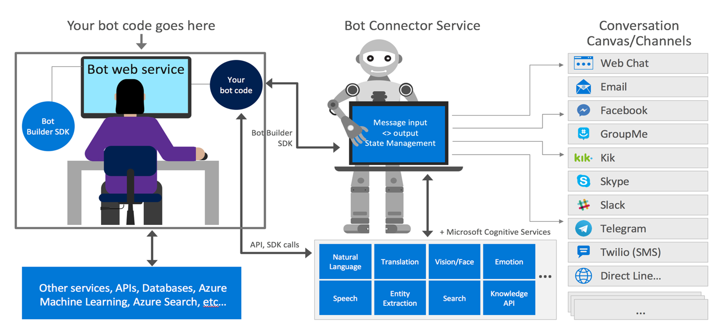
Bot Frame Work Components

Slide 154

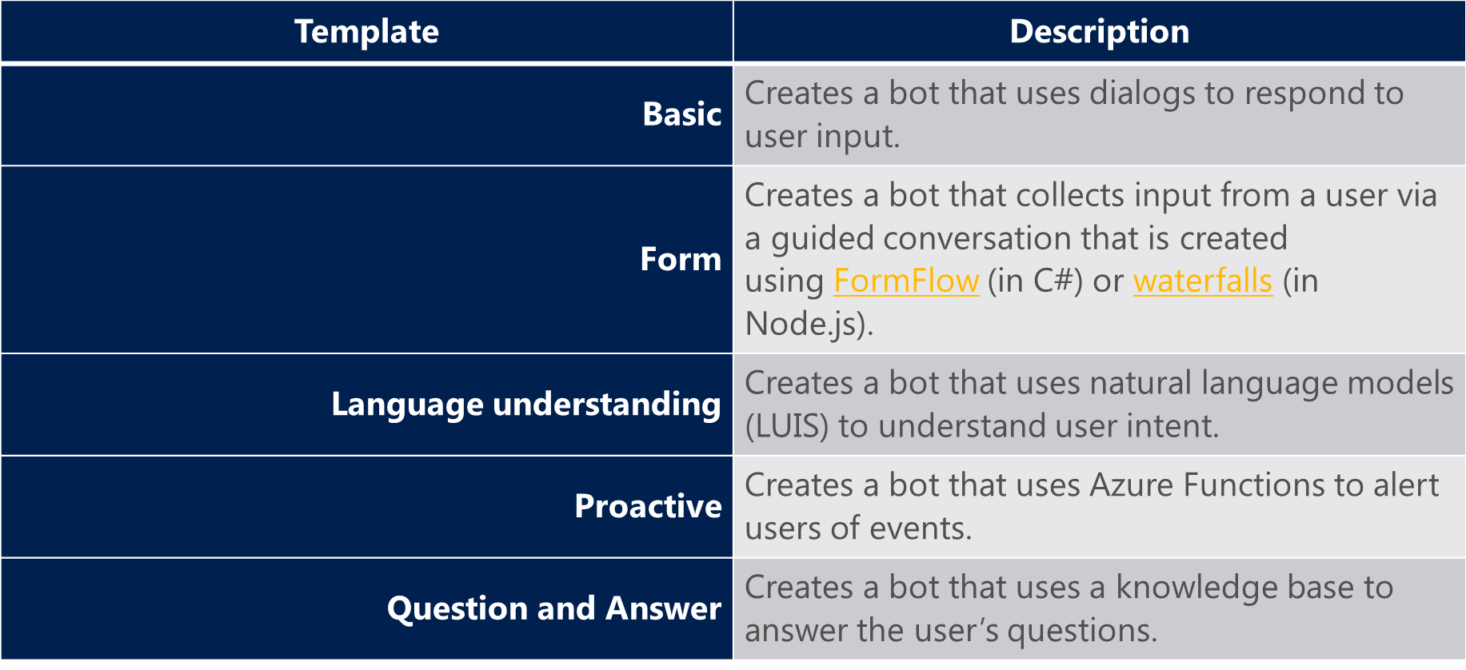

Slide 155
Planning for Bot Projects
PHASES | ACTIVITIES | INPUTS | OUTPUTS | TOOLS & TECHNIQUES
Initiating | Industry Type Identification | Discussions with Stake holders | Industry Type Definition | Meetings/Emails
 | Use Cases | Discussions with Stake holders | Use cases | Meetings/Emails
Planning | ChatBot Type-LUIS (Q&A, LUIS, Deep Learning) | Use cases | ChatBot Type | Use cases
 | Bot Builder(C#, Node.js) | Use Cases | Type of Bot Builder | Use cases
 | List of Intents | Use Cases | Intents | Bot Framework
 | List of Entities | Intents | Entities | Bot Framework
 | List of utterences | Entities | Utterences | Bot Framework
 | List of API's to be integrated | Intents,Entities,Utterences,Use cases | API's | Node.js
 | Channel for Publishing (Skype,Slack,Messenger,Email,FB,KIK) | Stake holder inputs | Channel | Selected Channel

Slide 156
Planning for Bot Projects
PHASES | ACTIVITIES | INPUTS | OUTPUTS | TOOLS & TECHNIQUES
Executing | Create Azure subscription | subscription detilas | Azure account to create a bot | Azure Portal
 | Creating a Bot | MS Bot framework | Basic Bot | Bot Framework
 | Train Intents,Entity and Utterences | List of Intents,Entities,utterences | Trained Bot | Bot Framework
 | Integrate the API's | Api's List | Bot | Bot Framework
 | Deploy the Bot | Bot |  | Bot Framework
 | Connect to channel | Identified Channel | Availability of Bot on identified Channel | Selected Channel
Monitering Controlling | Test the Bot | Bot | Modifications Required | Bot Framework
 | Modify the bot source and redeploy the Bot | Modifications | Modified Bot | Bot Framework
Closing | Publish the Bot | Modified Bot | Final Bot | Selected Channel
Notes:
Entities
Utterances

Slide 157
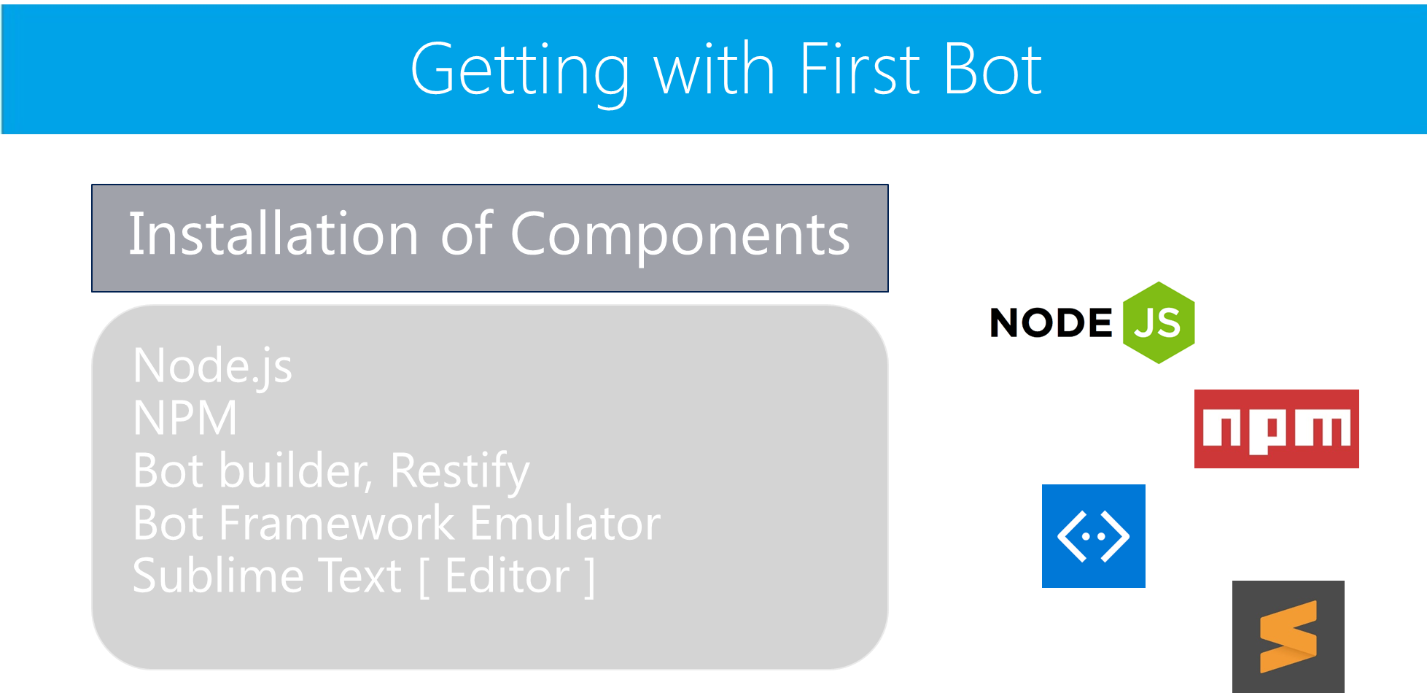

Slide 158
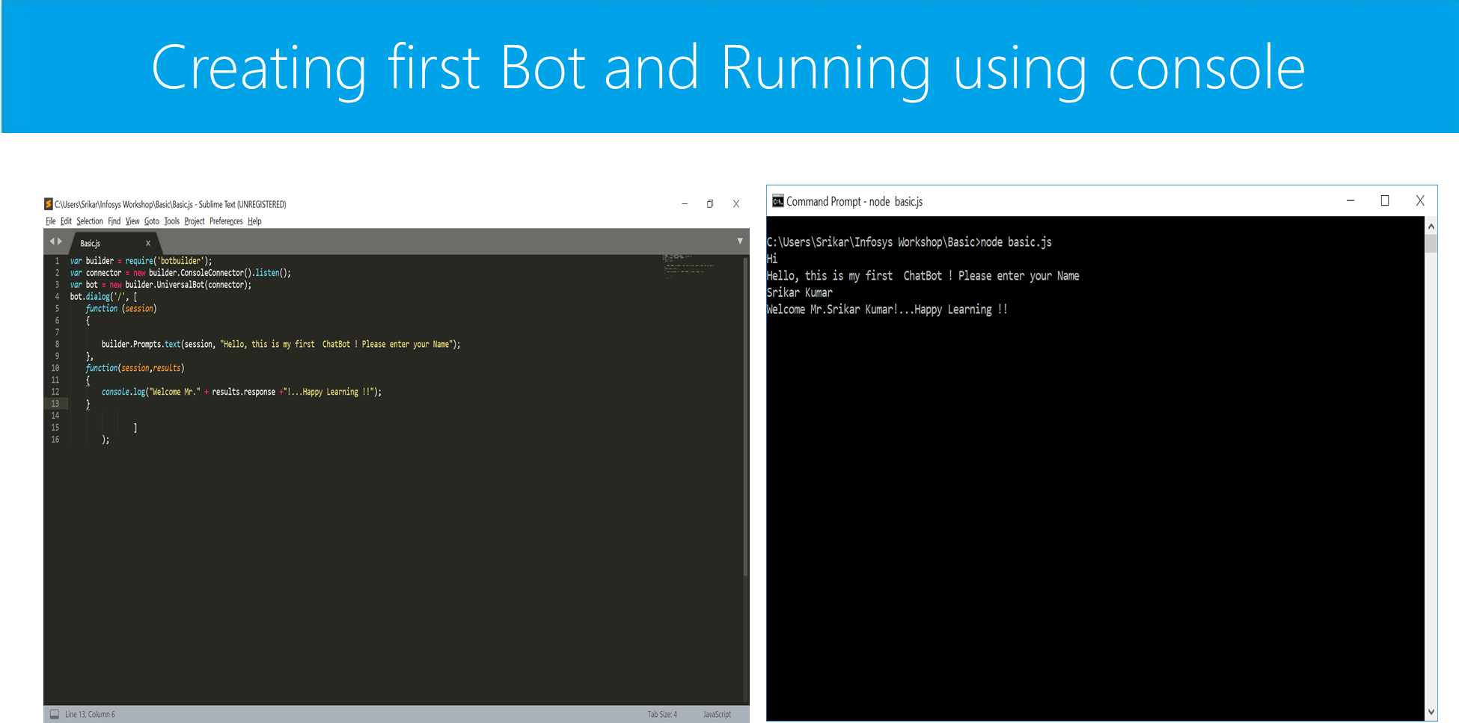

Slide 159
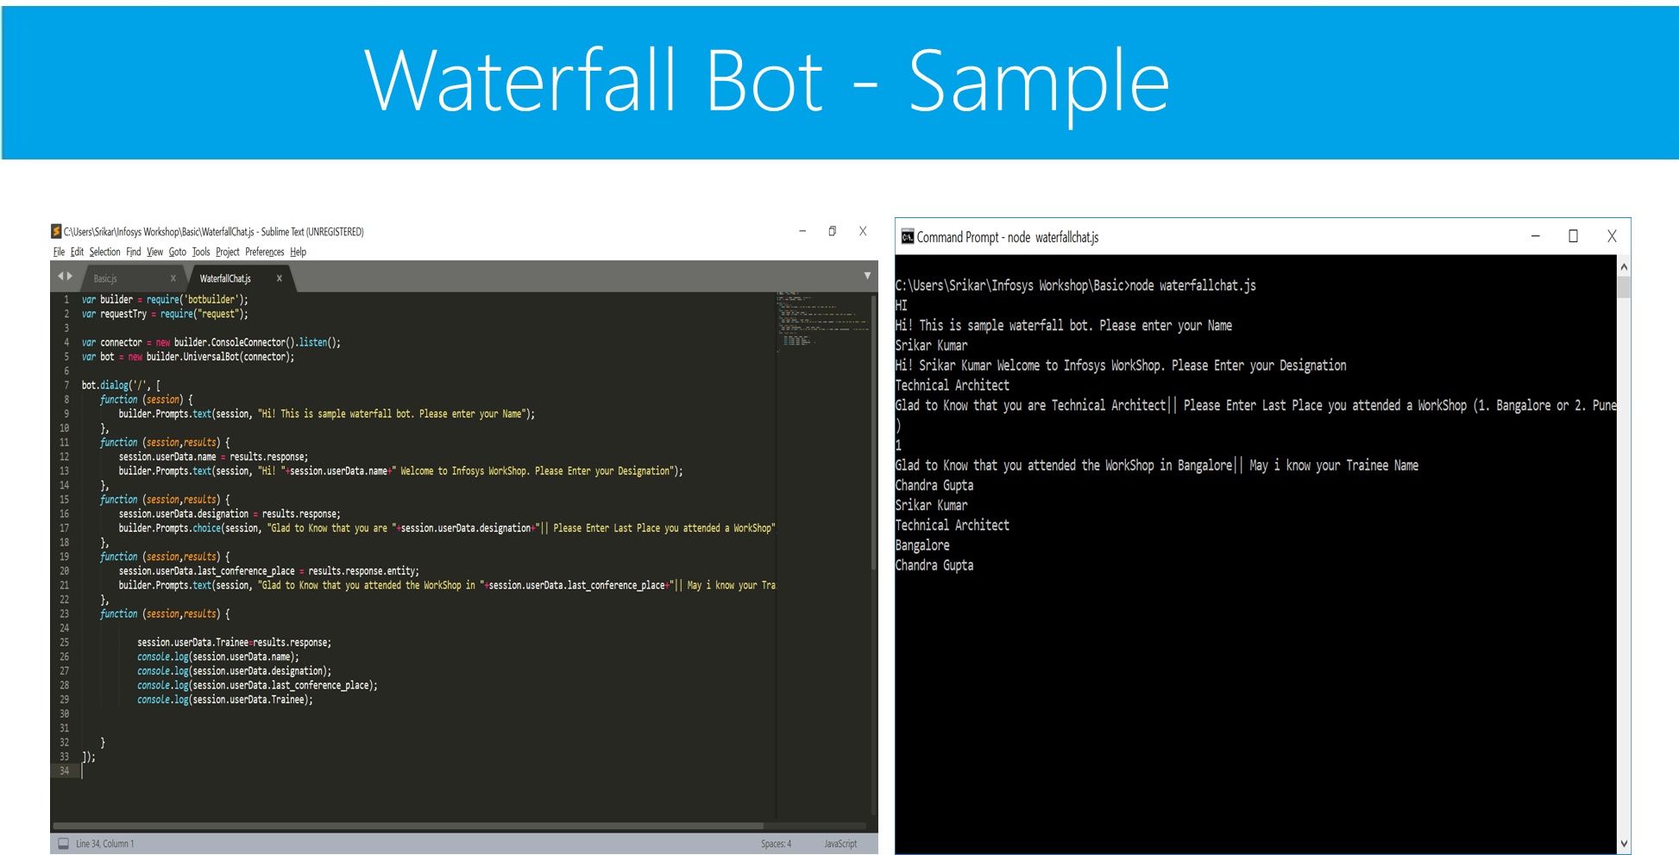

Slide 160


Slide 161
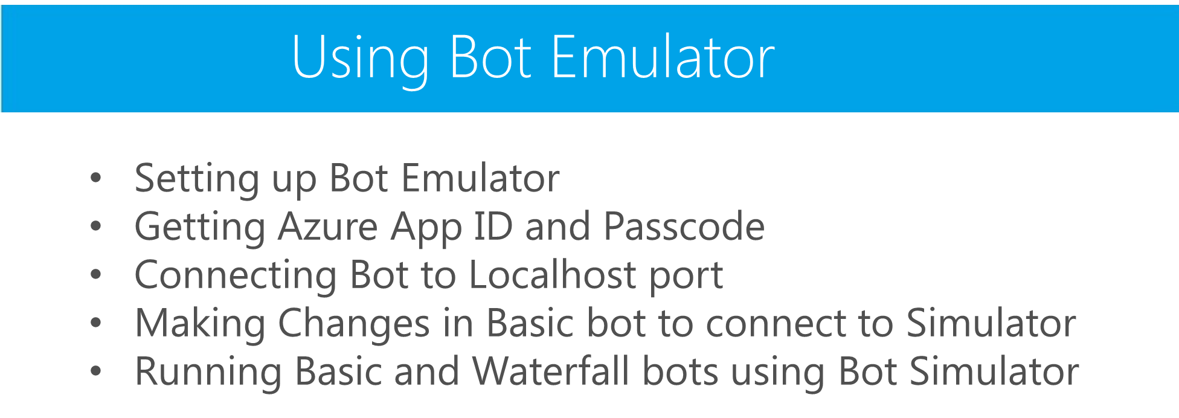

Slide 162
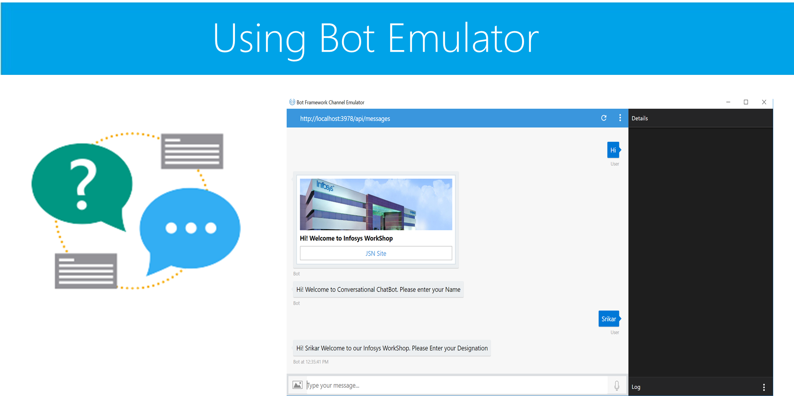

Slide 163

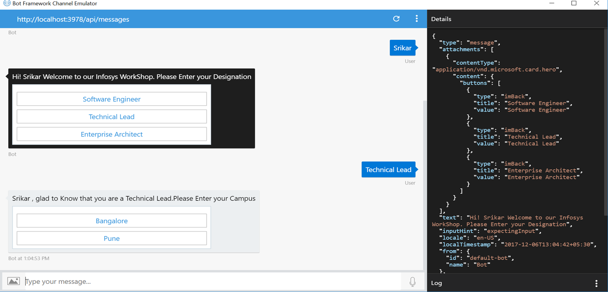

Slide 164

Hands on Lab

Slide 165
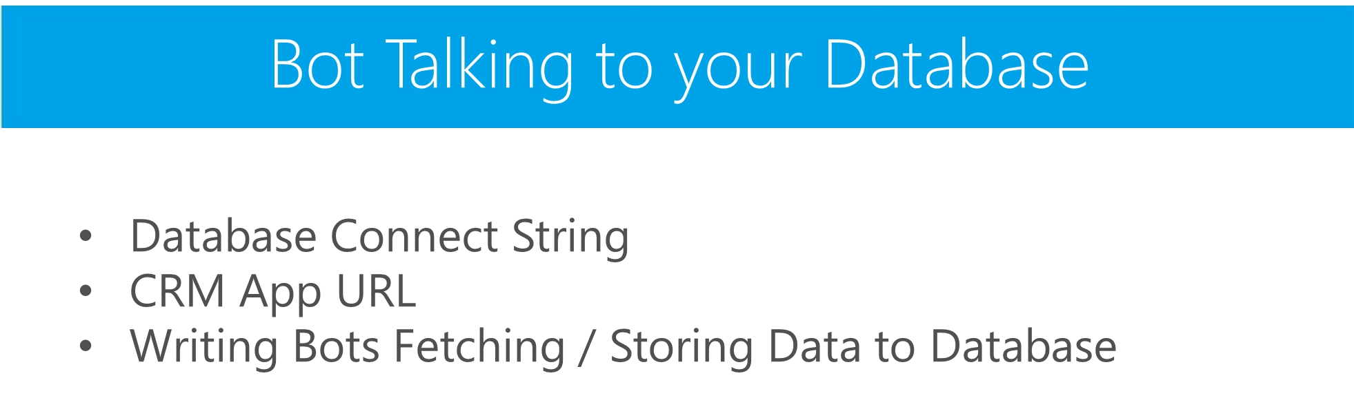

Slide 166

Hands on Lab

Slide 167

From FAQ to Bot in minutes.
Build,train and publish a simple question and answer bot based on FAQ URLs,structured documents or editorial content in minutes.

Slide 168
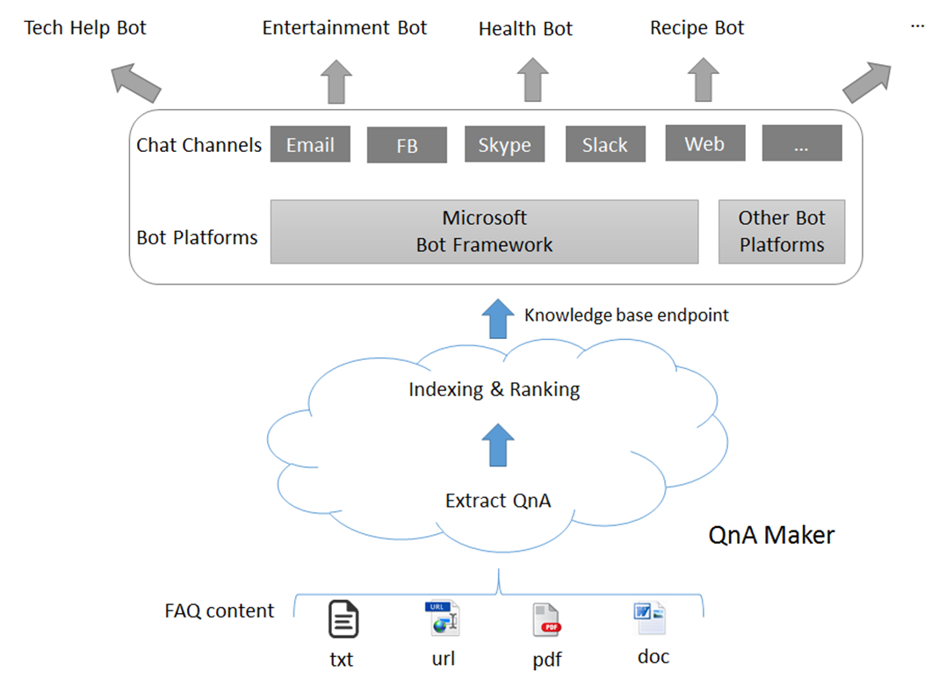
Development of FAQ Bots

Slide 169
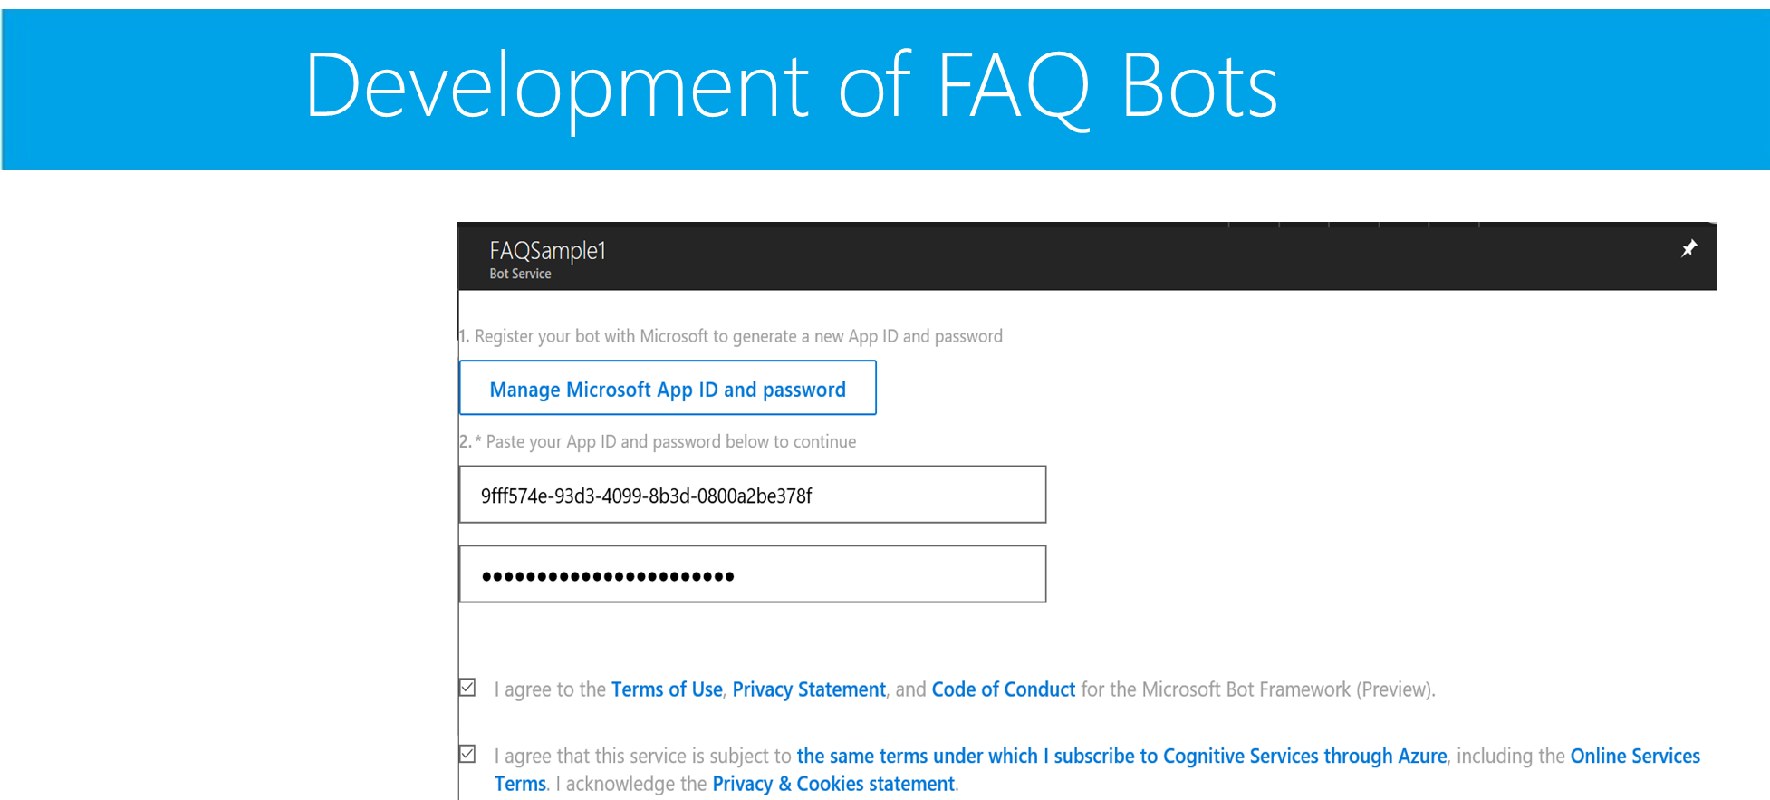

Slide 170
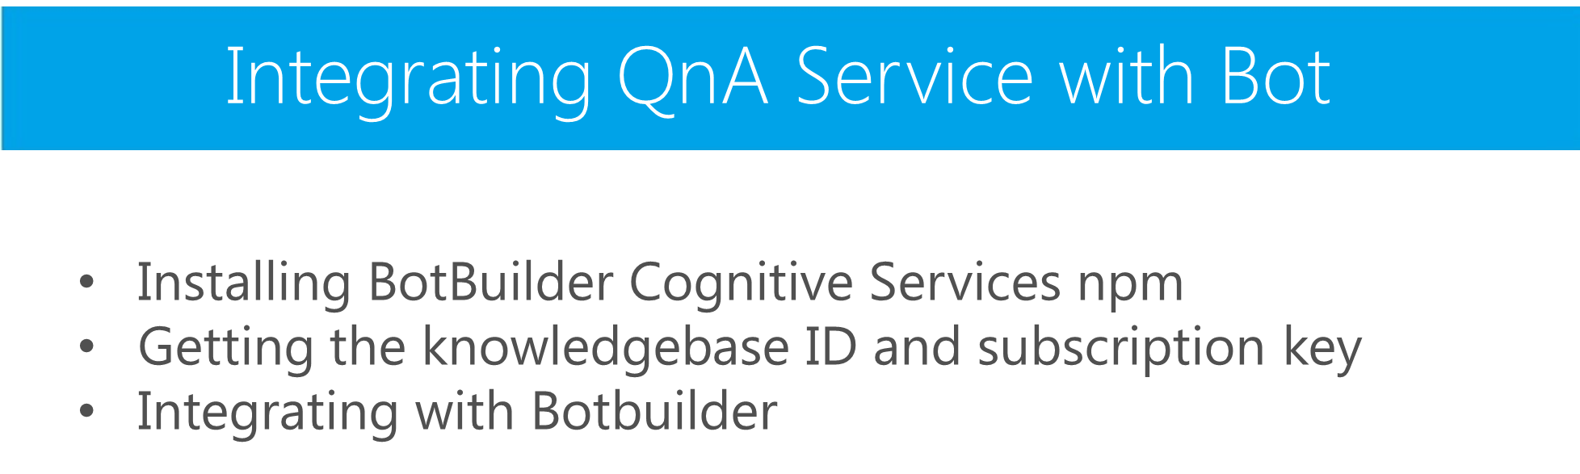

Slide 171

Hands on Lab

Slide 172
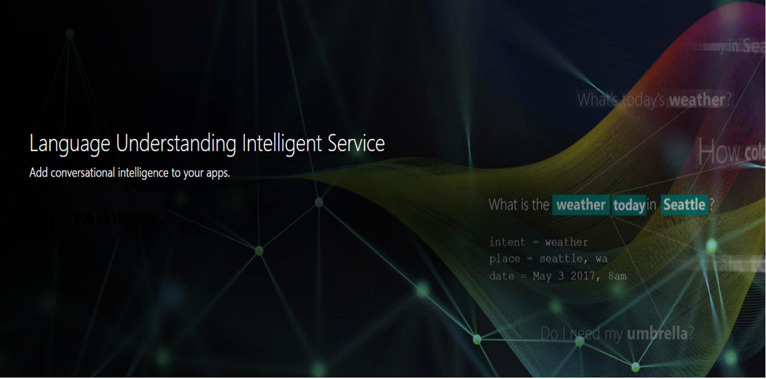

Slide 173
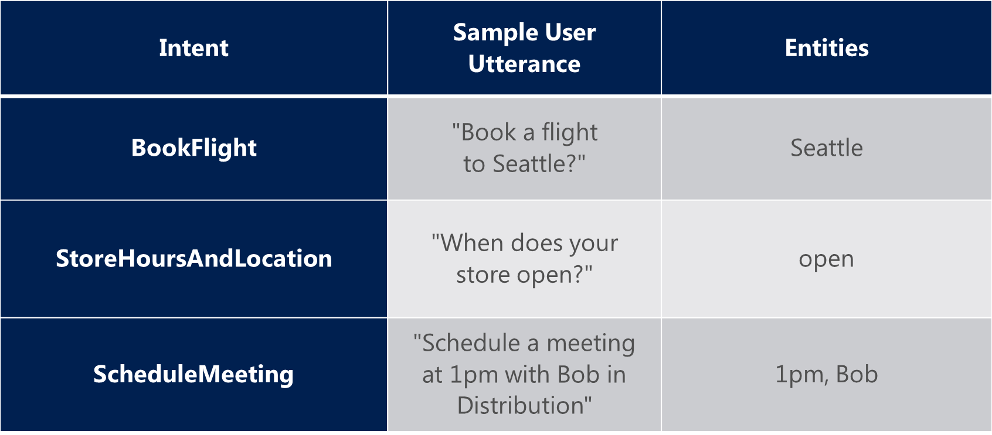
LUIS – KEY Concepts

Slide 174
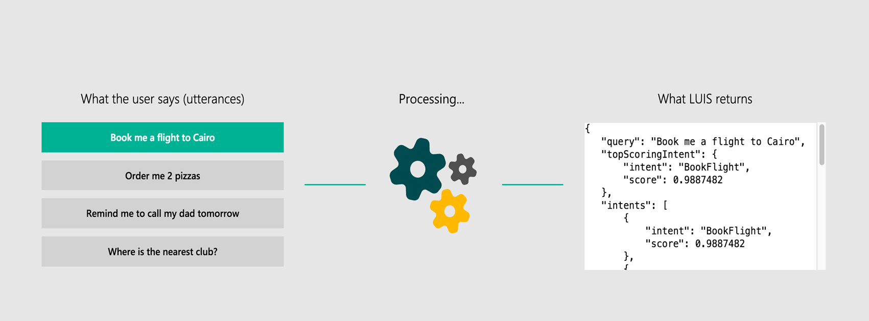
LUIS – KEY Concepts

Slide 175
Q&A

Slide 176

© 2016 Microsoft Corporation. All rights reserved.

